Slide 1




Working Group on Engineering and
Climate Change
Main activities and achievements
UNFCC COP28 side event Systems thinking for holistic climate action – 5 December 2023
UNFCC COP29 side event Accelerating Clean Tech for Energy and Agriculture in SIDS – 11 November 2024
Webinar: Principles for climate change adaptation and future resilience for engineers – 1st edition 19 December 2024 (132 attendees); 2nd edition 14 May 2025 (111 attendees)
“The Climate Change Mitigation Best Practice project” led by Prof. Jianping WU will be presented at the GA and GEC in Shanghai (October 2025)
“The WFEO Model Code of Practice: Climate Adaptation and Resilience for Engineers” led by David Lapp will be presented at the 2025 GA and GEC in Shanghai (October 2025)
Key message to the General Assembly
Let’s collaborate much more among STCs and WGs, it will make WFEO stronger and better
Engineering for Sustainable Development
Notes:
A new WFEO Working Group on Engineering and Climate Change was proposed by the Institution of Civil Engineers (UK) and accepted by the WFEO Board in September 2023. It was finally approved by the WFEO GA in Prague (October 2023)
Objectives of the Working Group are:
To coordinate efforts of all WFEO committees on climate change and find platforms to showcase these efforts.
To advance awareness of best practice in climate mitigation, adaptation and resilience, which could be through showcasing decarbonisation and/or climate resilience efforts of engineering projects and in the engineering profession.
To assist in the advancement of guidance tools and standards for decarbonisation, climate adaptation and resilience, through global expert advice to existing projects.
To raise awareness of WFEO’s work on and commitment to address climate change.
Key message to the General Assembly - Let’s collaborate much more among STCs and WGs, it will make WFEO stronger and better
The Working Group has been made aware there are activities in the climate change sphere (SDG 13) developed and delivered publicly by members of other STCs. Nonetheless, the WG is not always informed and almost never consulted. Engagement with the WG from other STCs on climate change is poor, with the high risk/certainty we do not have a WFEO coordinated approach to external communication on climate change matters.

Slide 2
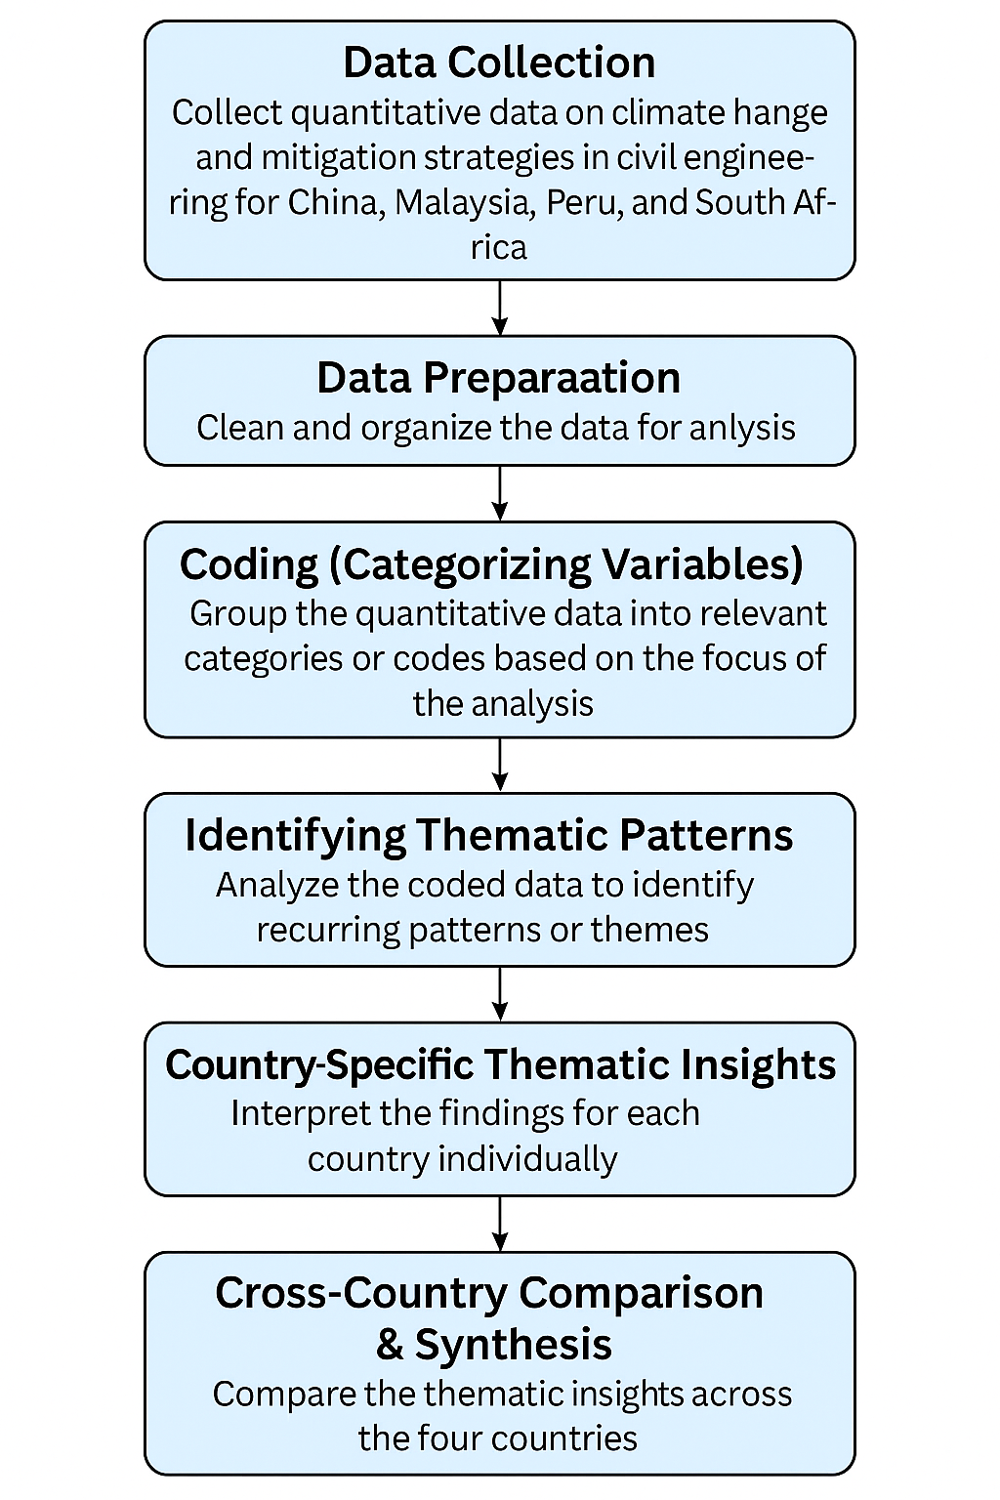
WFEO Climate Change Mitigation Best Practice Project
Objectives and Methods
The Progress
To make Engineers best Contribution to global climate change mitigation
How to ?
  Collect successful project examples from all WFEO member countries
  Share the best practice projects with all WFEO member countries
  Courses training for Engineers from all WFEO member countries
Project set up by WFEO in March 2021
Data from China, Malaysia, South Africa, and Peru collected
Technical reports and guidelines on the way
Guidelines
Sustainable Building Design
Material Innovation & Reuse
Technological Innovation
Waste Management in Construction
Energy Efficiency and Emission Reduction

Slide 3
WFEO Model Code of Practice: Climate Adaptation and Resilience for Engineers
15 Guidelines
Adopt Climate Considerations into Practice
Exercise ethical leadership
Respect human rights and ensure solutions do not disproportionately affect marginalized or vulnerable groups
Exercise engineering judgment
Exercise precautionary measures considering climate uncertainty
Be aware of potential legal liability
Interpret and specify climate information
Review the adequacy and application of locally applicable codes, standards and guidelines
Work with multi-disciplinary and multi-stakeholder teams
Plan for the infrastructure service life (life cycle)
Use risk management to pro-actively address climate uncertainties
Enhance the climate resilience of infrastructures and engineered systems
Design and implement solutions, including nature-based, that consider long-term environmental, economic, and social impacts
Use effective language and communicate decisions clearly
Engage in lifelong learning and ongoing engagement to stay current with evolving climate science, climate resilient technologies, standards, tools and methods
Notes:
WFEO Model Code of Practice: Climate Adaptation and Resilience for Engineers
Summary
17 October 2025
The following 15 guidelines, grouped into three categories, encompass the principles and practices of climate adaptation and resilience applied to the practice of engineering in civil infrastructure and building projects that are executed by, and the responsibility of, engineers. These apply in all facets of planning, design, construction, operation, maintenance and decommissioning in which engineers are engaged.
ETHICAL AND PROFESSIONAL PRACTICE AND CLIMATE
Adopt Climate Considerations into Practice
Engineers should include an understanding of the changing climate and extreme weather events on infrastructure resilience into the design, construction, operation, maintenance, decommissioning, planning and procurement activities for which they are responsible.
Exercise ethical leadership
Engineers should act as ethical leaders, guiding climate adaptation and resilience projects to respect safety and resilience of end users, environmental limits and the needs of future generations.
Respect human rights and ensure solutions do not disproportionately affect marginalized or vulnerable groups
Engineers should consider how climate adaptation and resilience projects affect different social groups and ensure that solutions are equitable and just, with a focus on inclusivity. Ensure inclusive decision-making by actively involving women and minorities in the design and implementation of climate change adaptation and resilience strategies.
Exercise engineering judgment
Engineers should consider the implications of climate change for each project, including adjustments to codes, standards and regulations as needed to meet the needs for climate resilience and create a clear record of the outcomes of those considerations. Prioritize sustainable solutions that deliver safety and resilience of end users, protect natural resources, minimize waste, and reduce the carbon footprint, while being financially affordable and ensuring future generations benefit from climate resilient infrastructure and buildings as well as a healthy environment.
Exercise precautionary measures considering climate uncertainty
In the face of uncertainty about climate change impacts, engineers should take a precautionary approach, prioritize prevention and minimize potential harm. Implement proactive risk mitigation and climate resilience measures where there are threats of serious climate related damage or destruction even in cases where there are unavailable, scientifically inadequate or highly uncertain climate data or projections.
Be aware of potential legal liability
Engineers should take reasonable steps so that current and future potential legal liability from their practice in general and to particular engineering work is understood by taking actions that incorporate climate considerations in work for civil infrastructure and buildings and documenting such considerations.
B. INTEGRATE CLIMATE AND CLIMATE-BASED INFORMATION
Interpret and specify climate information
Engineers should work with climate and meteorological specialists/experts with local knowledge to specify needs for climate data, information and future projections and engage them for interpretations of derived climate parameters to ensure these are scientifically defensible and reasonably reflect the most current scientific understanding.
Review the adequacy and application of locally applicable codes, standards and guidelines
Engineers should review the local design codes, standards and regulations and determine whether these reasonably represent the current and anticipated climate in the location that an infrastructure will operate over its life cycle. Specify, review and or adjust operation and maintenance procedures and standards to adjust as necessary for climate resilient infrastructure over its complete life cycle. Consider exceeding design codes and standards where it is prudent to do so and document the rationale.
C. ENGINEERING PRACTICE GUIDANCE
Work with multi-disciplinary and multi-stakeholder teams
Work with other engineers, other infrastructure practitioners, climate specialists and natural scientists to form multi-disciplinary project teams to engage with stakeholders (infrastructure owners, the public), gaining a common understanding of the risks, vulnerabilities and impacts (physical, social and environmental) of current and future climate on the infrastructure and its service to the society it serves. Engage these teams to develop feasible adaptation and resiliency measures within project constraints to ensure a comprehensive approach to climate adaptation and resilience.
Plan for the infrastructure service life (life cycle)
Consider the impact of current and projected climate (long term changes and climate extremes) over the entire service life of an infrastructure. Make appropriate and feasible decisions within the context of current scientific, economic, project and social constraints through enhancements in design, construction, operations, maintenance, decommissioning and management procedures and practices.
Use risk management to pro-actively address climate uncertainties
Develop and maintain a reasonable level of competence and experience in infrastructure climate risk and vulnerability assessment as well as risk management. Be aware of and utilize recognized procedures, processes and tools based on ISO internationally recognized climate risk and adaptation standards.
Enhance the climate resilience of infrastructures and engineered systems
Develop robust designs and enhance operations and maintenance policies and procedures to increase the capacity of infrastructures and engineered systems to withstand a greater range of current and future anticipated extreme weather events. Engage with other responsible parties in the planning and design of emergency response measures to deal with immediate impacts. Additionally, develop and implement strategies and methods to accelerate rehabilitation and reconstruction of infrastructures and engineered systems from damage or loss to restore service as soon as practical.
Design and implement solutions, including nature-based, that consider long-term environmental, economic, and social impacts
Consider both immediate and future risks (e.g., climate creep, sea-level rise, extreme weather), as well as any probable combination of each when designing resilient systems to last over the entire service life of an infrastructure. Investigate and consider nature-based solutions (NbS) i.e. green infrastructure to complement or replace grey or engineered infrastructure.
Use effective language and communicate decisions clearly
Communicate to clients, employers and the public as appropriate, providing transparent information about risks, benefits, and potential impacts, climate-related and resiliency recommendations using simple, unambiguous, language. Include the costs and benefits of recommended actions, how those actions mitigate the identified risks as well as the economic benefits of the adaptation and resilience measures and the potential costs of not adapting to the identified risks.
Engage in lifelong learning and ongoing engagement to stay current with evolving climate science, climate resilient technologies, standards, tools and methods
Pursue continuous learning to ensure work remains relevant, reflects best practices and
innovations and is ethically sound. Stay informed about new technologies, methods, and strategies to improve climate resilience and share these findings with the engineering community and fellow engineers. Support and engage in research and demonstration to develop innovative, efficient, and sustainable technologies and methods to enhance climate adaptation and resilience.

