Slide 1


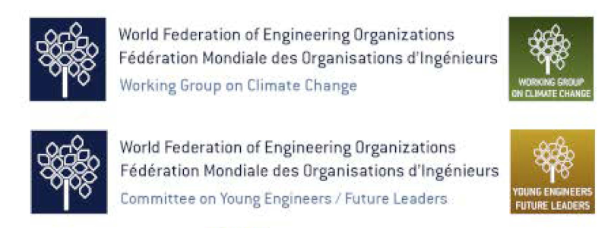

Inspiring collective action through communication, advocacy and best practices – the role of engineers
14 March 2024

Slide 2
WHEN ENGINEERS AND SCIENTISTS NEED
SOCIAL SCIENCE SKILLS TO GET THEIR JOBS DONE
By Craig Tinashe Tanyanyiwa, PhD

Slide 3
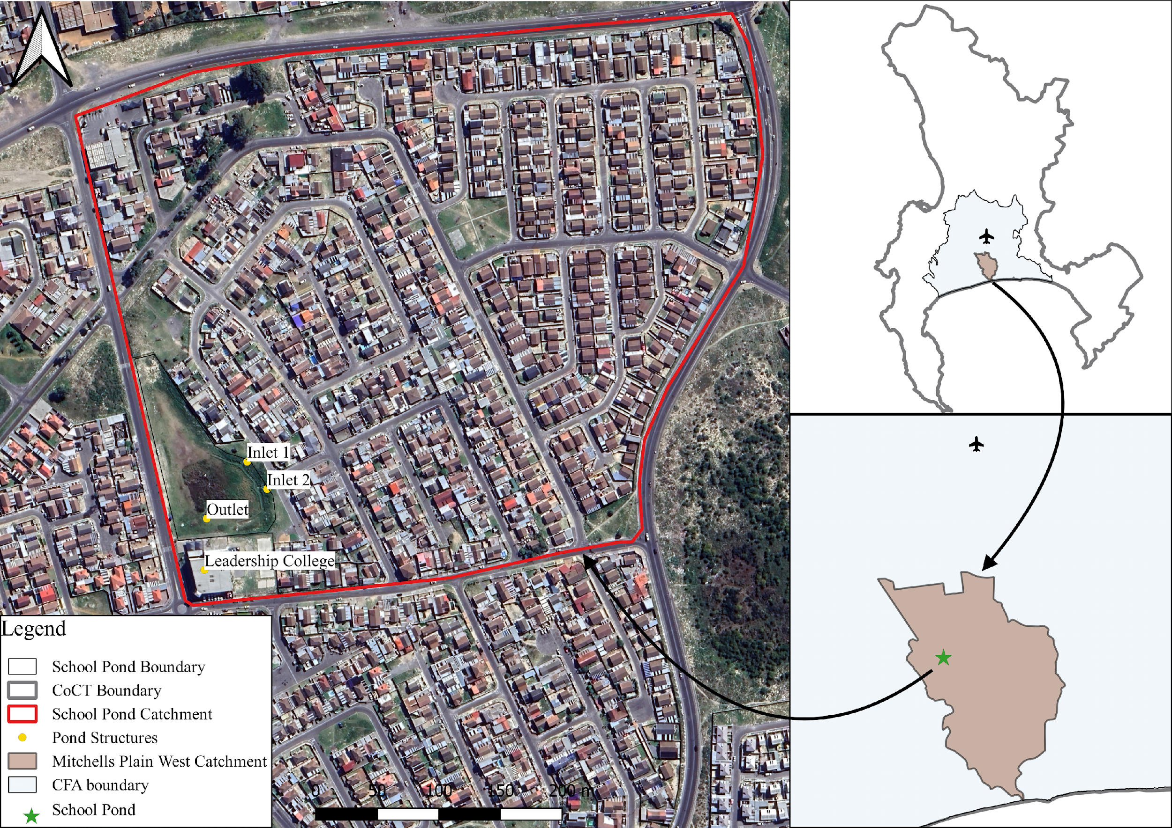
RETROFITTING A DETENTION POND
Located in Rondevlei, Mitchells Plain, Cape Town, South Africa
Low-middle income neighbourhood
Catchment Area – 170 000 m²
Pond Area – 7000 m²
Two inlets, one outlet
Fluctuating water table

Slide 4
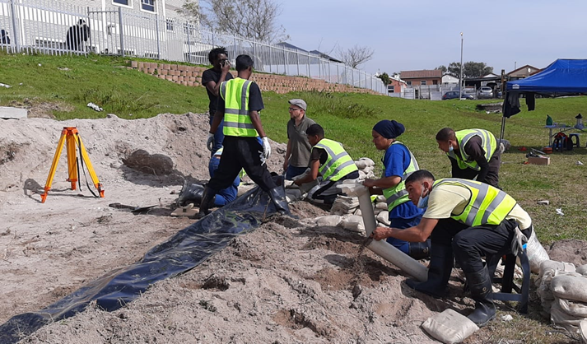
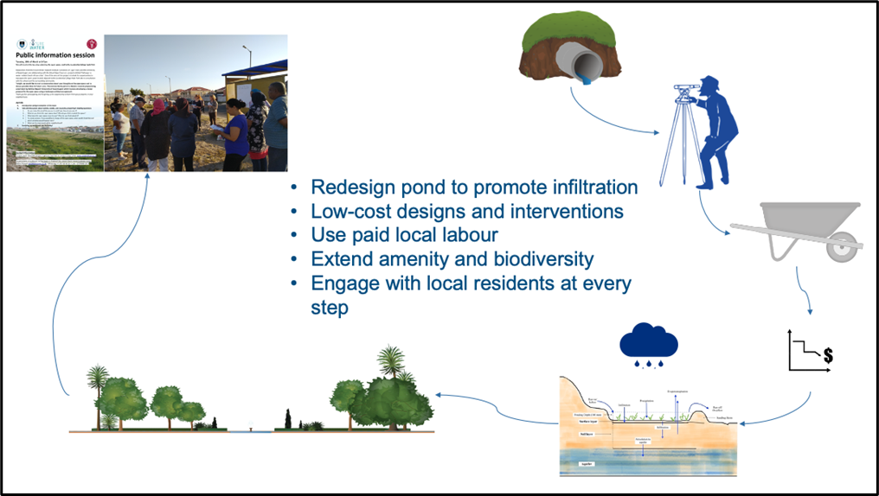
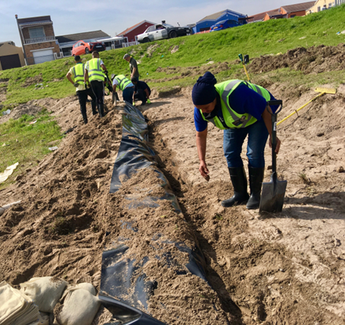
RETROFITTING A DETENTION POND

Slide 5
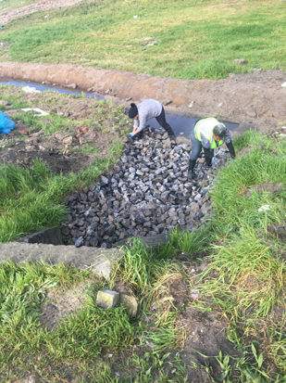
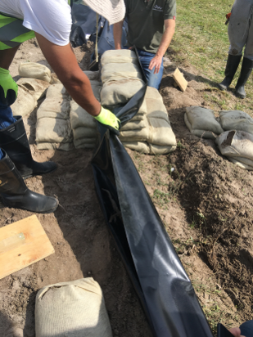
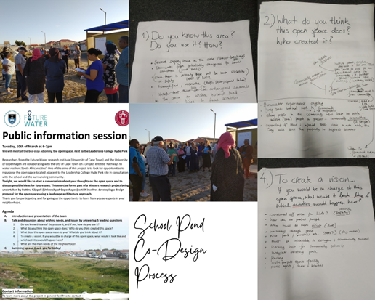
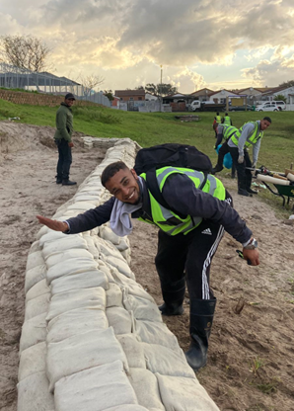
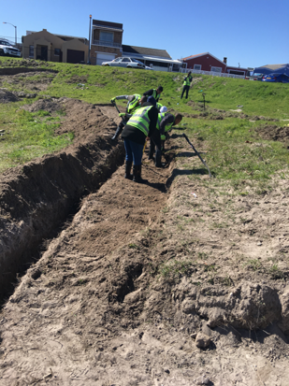
This wasn’t in my curriculum …

Slide 6
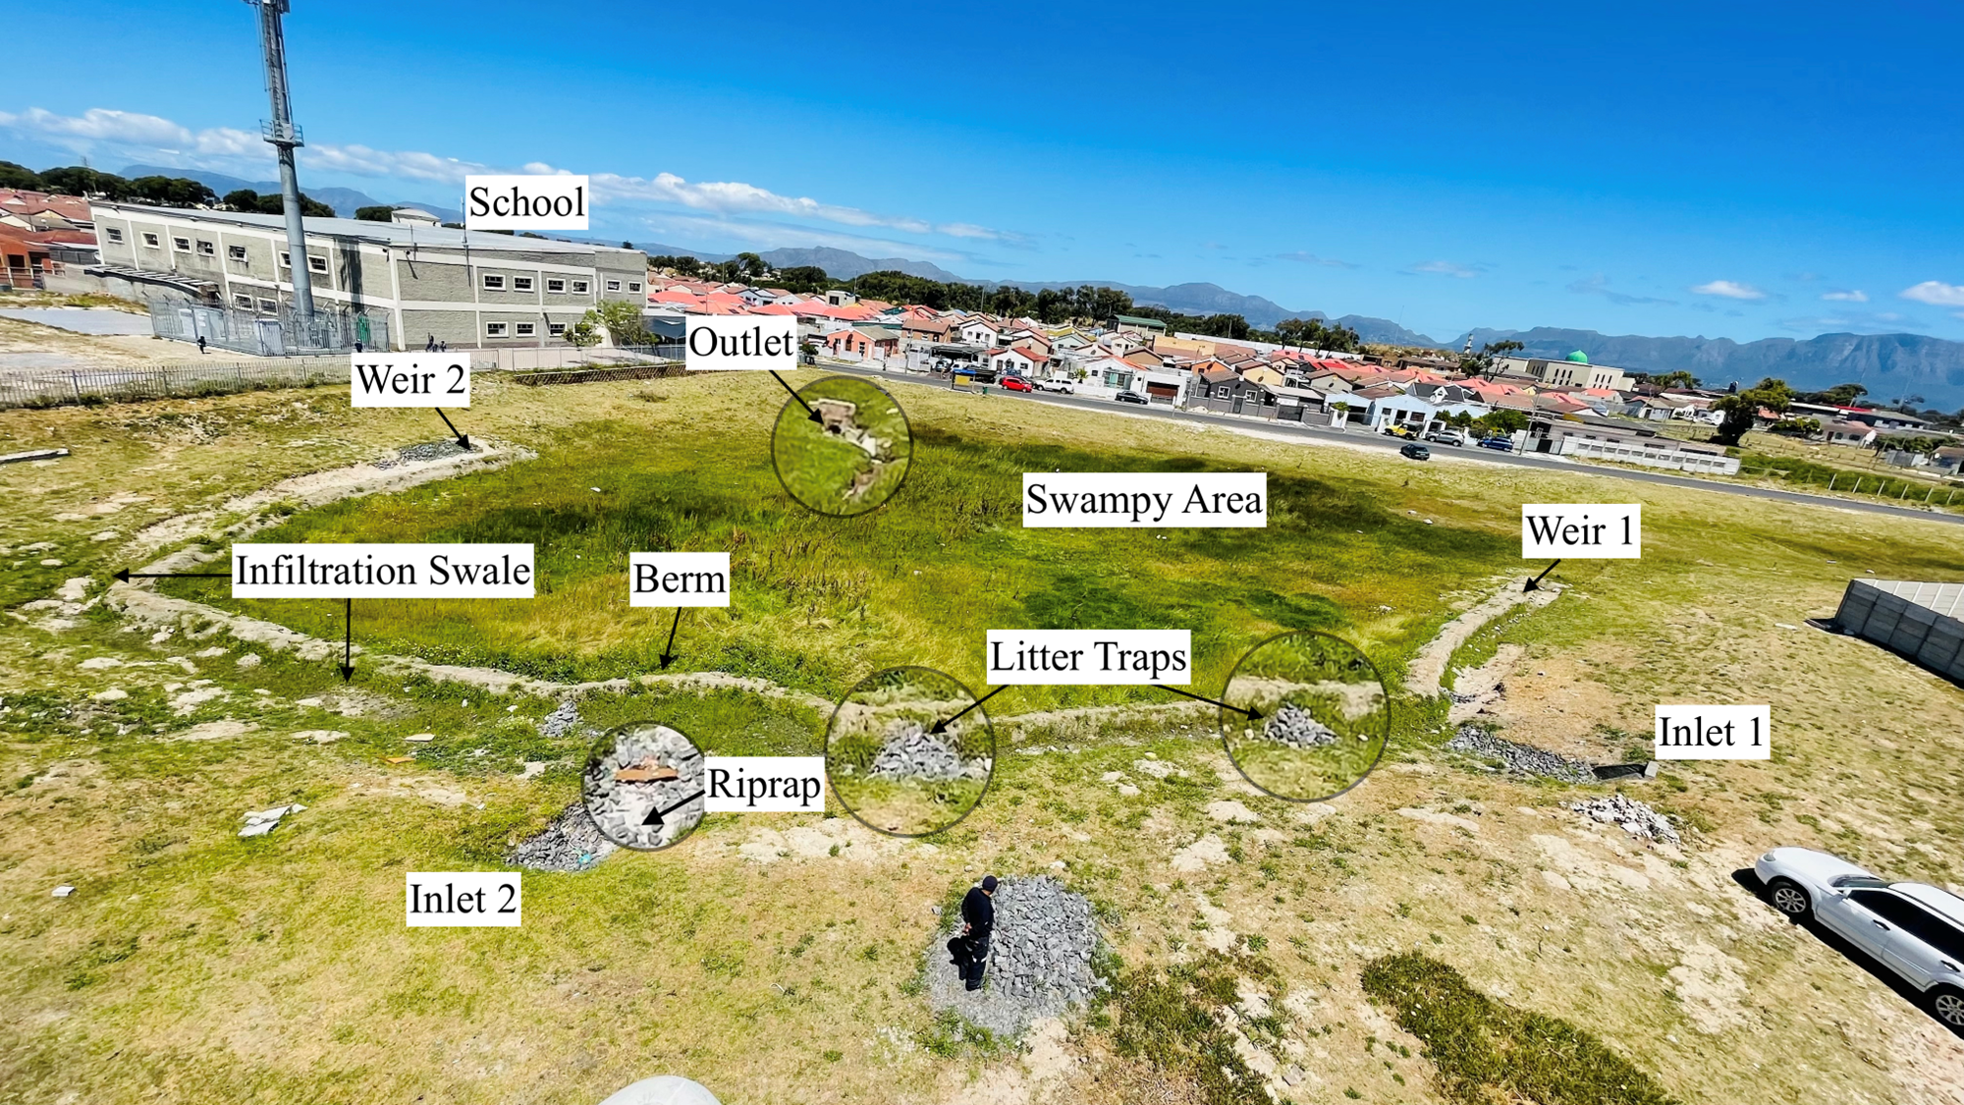

Slide 7
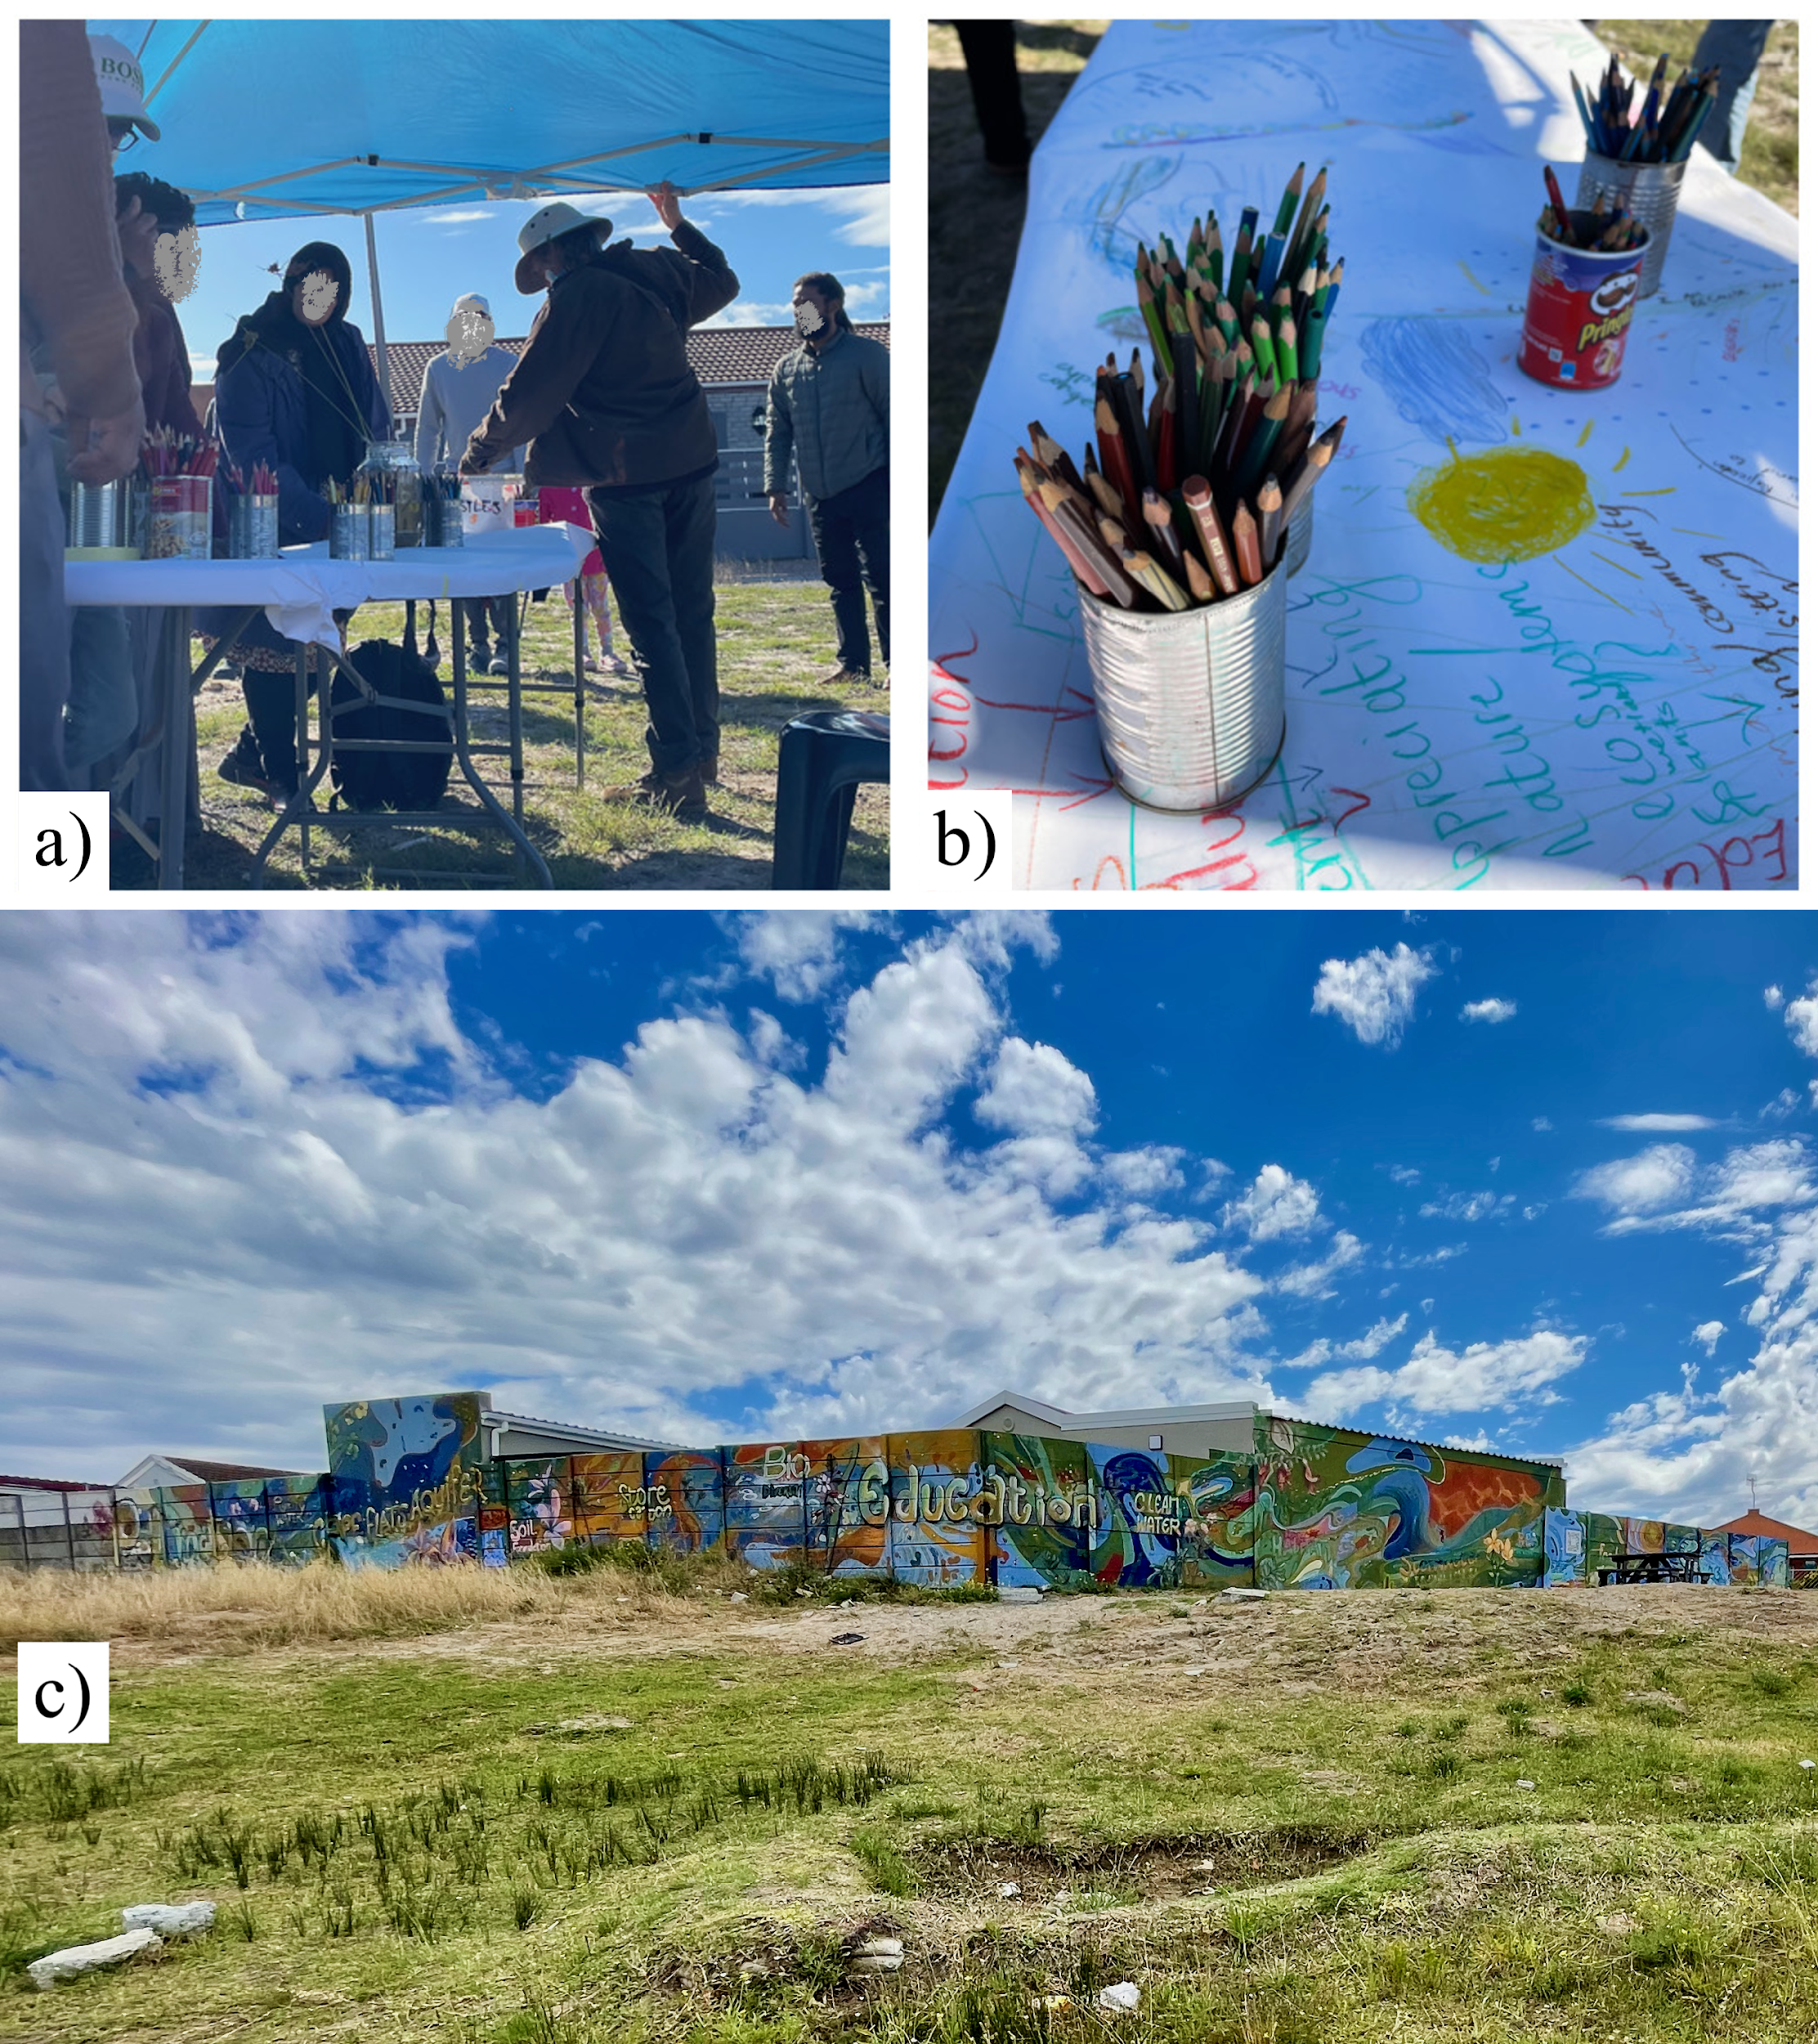
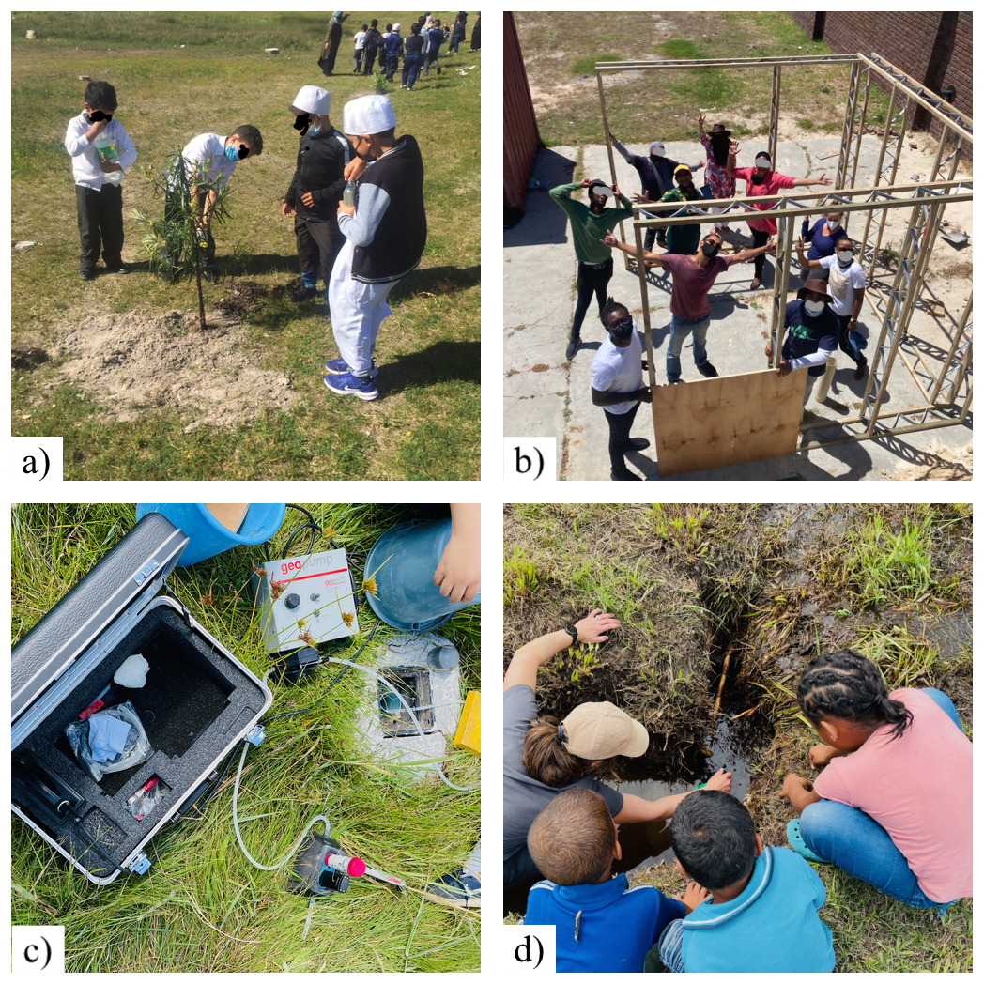
1
2
3
4
5
January 2020 - October 2021
Pre-construction and during the retrofit construction.
Activities: co-design, selection of workers retrofit construction
November 2021 - May 2022
Post-construction
Activities: Planting day, sandbag construction workshop, stormwater and groundwater sampling
Assessing Community Engagement
June 2022 - January 2023
Post-construction
Activities: Stormwater inflow data, pond clean-ups, mural inception and mural workshops, mural painting
February 2023 - June 2023
Post retrofit construction
Activities: Installation o benches, mural launch, clean up day, plant identification and engagement day
July 2023
Overall assessment of the project

Slide 8
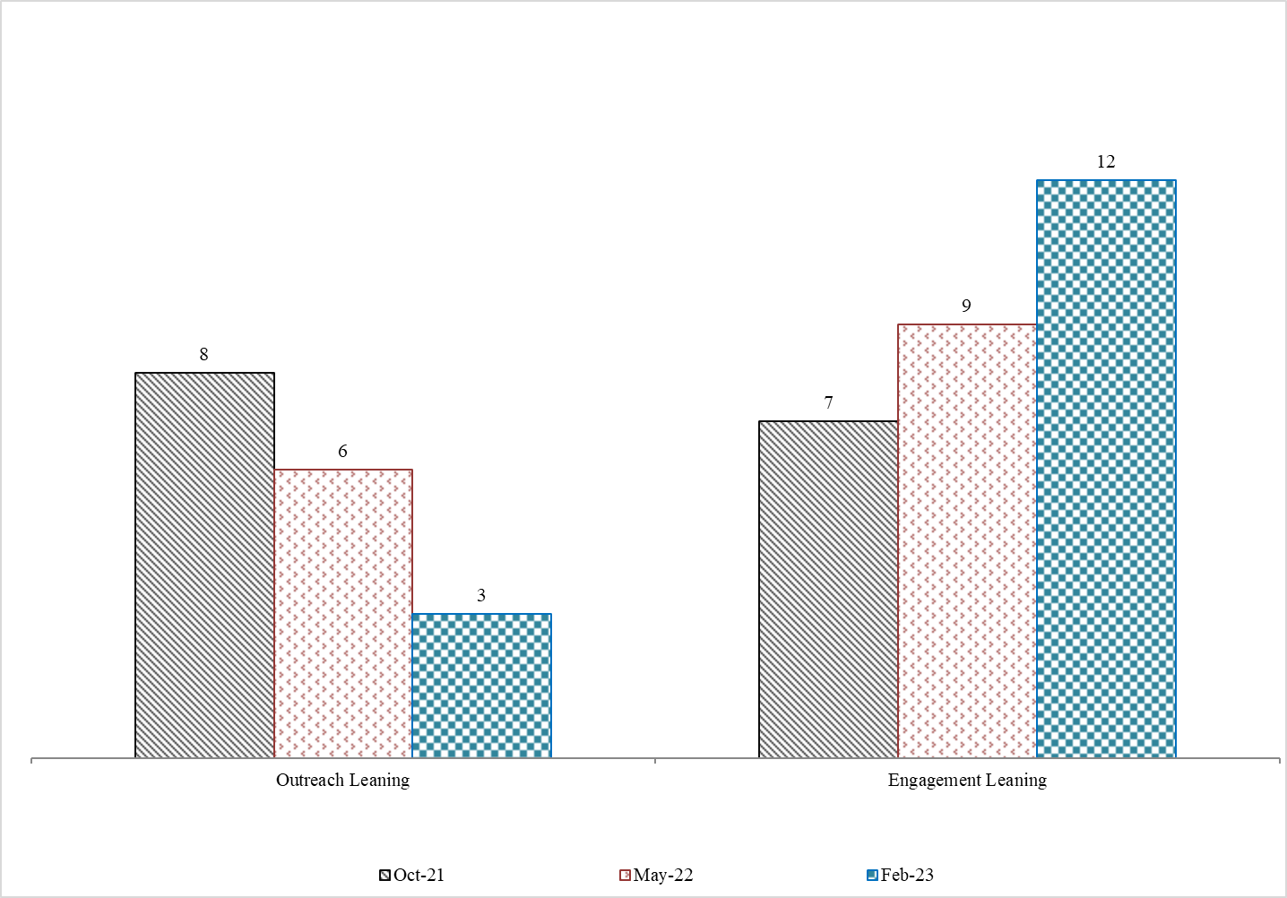
Aggregate of responses for all assessment periods

Slide 9
ANALYTICAL FRAMEWORK
Leaning and learning from Trisos et al., 2021
'Decoloniality and anti-oppressive practices for a more ethical ecology'
01
02
03
04
05
Decolonising the [technical] mind
Knowing (and attending to) the local histories
Decolonising access
Decolonising expertise
Practising ethical ecology in inclusive teams

Slide 10
DISCUSSION
Decolonising the technical mind: Reflecting on the limitations of technical science disciplines in social engagements
Engineer
The engineering of these systems – though essential – is often the easiest part, yet engineers are often expected to work outside of their field … They are then criticised for not being knowledgeable in these other fields. If the City is to move toward WSC, they must employ people with complementary expertise to assist the engineers.
Urban water management
The importance of really listening and realising that water management in cities needs to be considered as part of the much larger system that comprises people and their aspirations and beliefs, ecosystems, governance processes, politics, and economics.
Knowing (and attending to) the local histories
Urban sustainability researcher
Considering this specific context, a team whose racial composition mirrors the neighbourhood might have been better received initially. However, where that is not possible, these contextual realities could be addressed at the outset to insulate the 'outside' from micro and macro racial aggressions.
Coming from a more homogenous society . . . Engaging with people who have been forced to relocate, live in areas with gangsterism and have been 'let down so many times'… are all experiences which … play out when meeting outsiders or city officials… [I] learned that communication and involvement across the neighbourhood are key but also that you cannot and maybe should not think that you can make all happy … There are going to be setbacks where both sides are finding out more about each other … It takes time.
Engineer

Slide 11
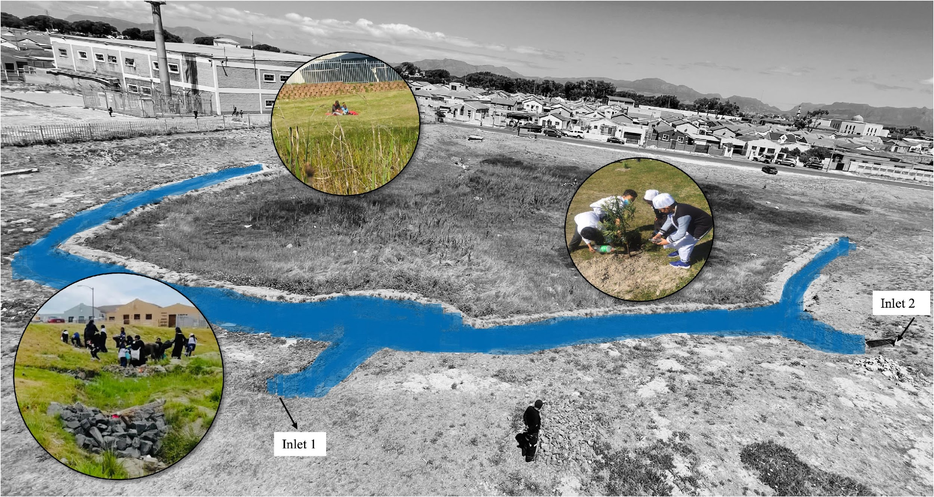
DISCUSSION
Decolonising access
Access to space and information
More generally, the PaWS intervention created a new kind of space that residents highlighted as a biodiversity hotspot – an important access point to green spaces in a context where these are limited (often to wealthy neighbourhoods).
Decolonising expertise
residents are experts in their own lives
Practising ethical ecology in inclusive teams
our process highlighted the centrality and importance of local engagement/buy-in.

Slide 12
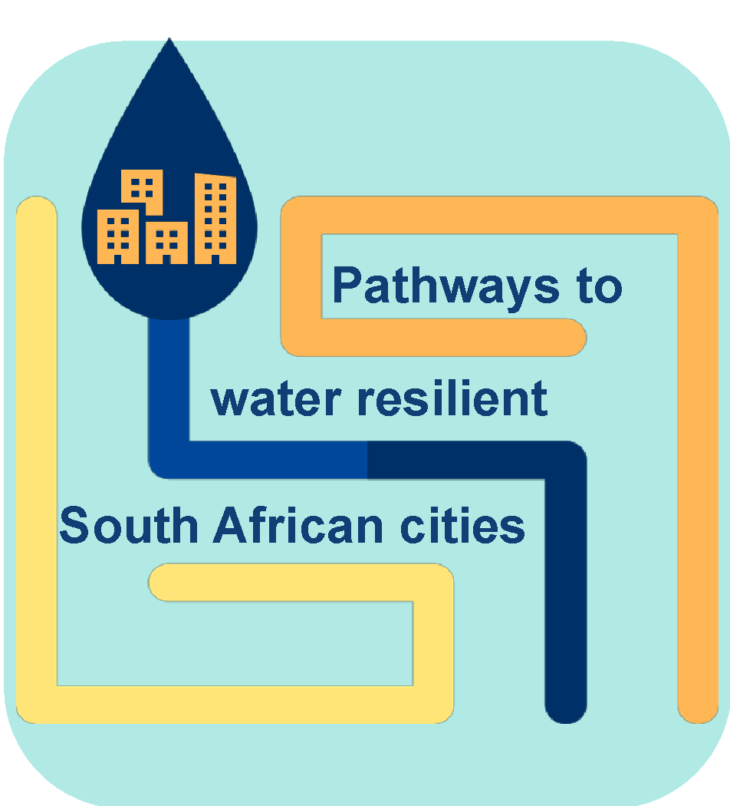




This work forms part of ‘Pathways to water resilient South African cities’
Project funded by:

Slide 13



The International Coalition for Sustainable Infrastructure and the World Federation of Engineering Organisation’s Young Engineers/Future Leaders Working Group on Climate Action proudly present
#EngineeringChange
Empowering young engineers to act on sustainable development.
Notes:
Initiated and is a collaborative effort between

Slide 14

01 - What is it all about?
A global initiative to empower young engineers to take action on the implementation of sustainable development in their workplaces, communities, and networks.
  Builds capacity
  Fills the gaps
  Equip young engineers
Notes:
Gaps created through limited perspective
Through global interaction and engaging in the content we share.
Through capacity building and knowledge sharing we will be able to equip young engineers on how to be effective when it comes to climate action and what’s needed in our evolving industry

Slide 15
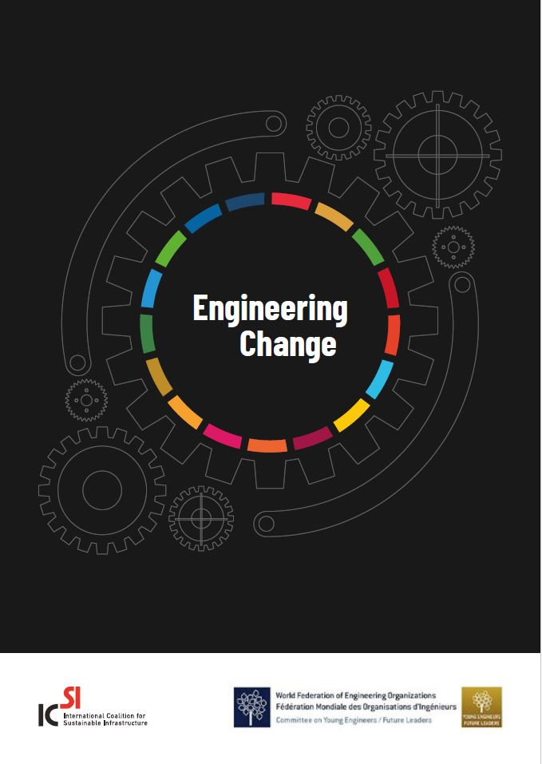

02 - Engagement
17 locations
Europe
Africa
North America
South America
Asia
Oceania
Notes:
-Young engineers perceive significant challenges in implementing sustainable practices, emphasizing concerns about inadequate resources and time allocation. Managers expressed more optimism about available support and resources.
-Young engineers recognise the diverse benefits of additional training. Tailored upskilling initiatives are crucial as, there were varying opinions based on experience levels and regional contexts. Experienced engineers expressed that there are barriers, rooted in resistance to change.
- Through upskilling young engineers' experience more job satisfaction, a sense of purpose, and professional growth, contributing to qualifications and increased responsibilities. Both managers and young engineers advocated for stronger initiatives to rapidly upskill the workforce in sustainable development, this was wonderfu and encouraging l to see on our end.

Slide 16

03 - Where to next
Targeted program over the next 12 months to empower young engineers and their managers as advocates for change, providing guidance and creating a platform for connection and resource-sharing within a community focused on sustainable development.
  Collation of existing training for training pathways.
  A call for case studies from young people implementing sustainable development principles in their work.
Notes:
We have a targeted program over the next 12 months which seeks to provide guidance and create a platform for connection and knowledge-sharing within the sustainable development community.

Slide 17


Join Us
#EngineeringChange
Scan this QR code to find out how you can get involved

Slide 18
Panel Q&A

Slide 19

Funding and Financing Sustainable and Resilient Infrastructure
Mark Crouch
Co-lead, ICSI’s Funding and Financing Sustainable Resilient Infrastructure Action Track

Slide 20
Investing in infrastructure that is fit for the future, our communities and the planet
Advocacy positions developed by the ICSI Action Track on Funding and Financing Sustainable and Resilient Infrastructure
With support from the Global Covenant of Mayors and the Institution of Civil Engineers
Notes:
There is an urgent need to unlock funding for equitable, sustainable and resilient infrastructure across the globe and to prioritise infrastructure that delivers positive outcomes for people and the planet.
These advocacy positions have been developed by the ICSI Action Track on Funding and Financing Sustainable and Resilient Infrastructure with support from the Global Covenant of Mayors and the Institution of Civil Engineers.
This set of key messages can be used to drive engineering-led impact and influence policy outcomes at global events and fora.

Slide 21
1
Infrastructure investment decisions must adopt a systemic approach that embeds low-carbon strategies and measures while enhancing the resilience of infrastructure systems to the benefit of communities and natural ecosystems.
Notes:
The engineering community strongly advocates for systemic interventions that consider climate resilience and adaptation and carbon mitigation, while delivering positive outcomes for communities and natural ecosystems.
These types of holistic, outcome-led, integrated interventions require inclusive engagement of a broad range of stakeholders across the infrastructure value chain, including local communities.
Engineers have the technical know-how to provide evidence-based, practical solutions to meet the demands of policymakers and to help increase investors’ confidence.
The potential trade-off between investing in resilience and adaptation and other policy drivers, such as achieving net-zero targets, should be accounted for and addressed.
Tailored policies and regulatory frameworks, strengthened governance and innovative financing approaches will incentivize and enable greater uptake of resilience and adaptation to climate change in infrastructure development, delivery and maintenance.

Slide 22
2
Closing the adaptation finance gap requires urgent focus, the right enabling environment, and a better articulation of the value delivered by these investments.
Notes:
Adaptation finance needs are 10–18 times as great as current international public adaptation finance flows – at least 50% higher than previously estimated, according to the UN Environment Programme Adaptation Gap Report 2023. We need an immediate increased focus on resilience and adaptation finance, particularly in developing countries.
Quantification of both the financial value and the wider benefits of resilience investments must improve. Investment is required to further develop the methodologies and tools required to make better, more holistic assessments, and more awareness raising is needed to catalyse interest from the ESG impact community worldwide. If a better explanation of the value and return of projects is provided, this would result in more capital being unlocked.

Slide 23
3
Communication of risks and returns, capacity building and knowledge transfer are key enablers of implementation at scale.
Notes:
Highlighting and clearly communicating the risks, benefits and cost of inaction that can be realised through infrastructure is key to acceptance and uptake among decision-makers and the public.
Local knowledge gaps among policymakers and practitioners must be identified and addressed. There are often insufficient resources for developing local capacity, preventing local stakeholders from engaging in new infrastructure projects or achieving a level of competency to sustain resilient projects.
Once financing is in place, the next major bottleneck is likely to be the capacity and capability of the global engineering community to implement just, sustainable, resilient and nature-positive infrastructure, particularly in developing countries where this is most needed.
The development, curation and dissemination of a database of solutions, resources and best practices would be an effective way to transfer knowledge across sectors, minimise duplication and accelerate uptake.

Slide 24
Next steps

Slide 25



World Engineering Day Webinar, 14th March 2024
WFEO CLIMATE CHANGE MITIGATION
BEST PRACTICE PROJECT
THE WFEO
Presented by Prof. Jianping Wu

Slide 26

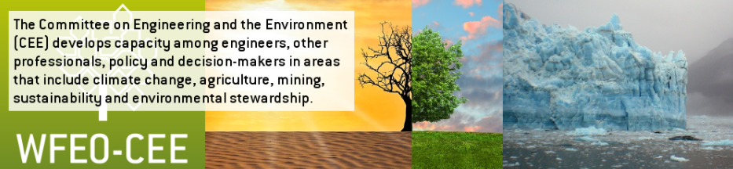
The Aim
The aim of the project is to make best Engineers Contribution to global climate change mitigation
How to ?
  Collect successful project examples on climate change mitigation from all WFEO member countries
  Select and Share the best practice projects with all WFEO member countries as supports

Slide 27
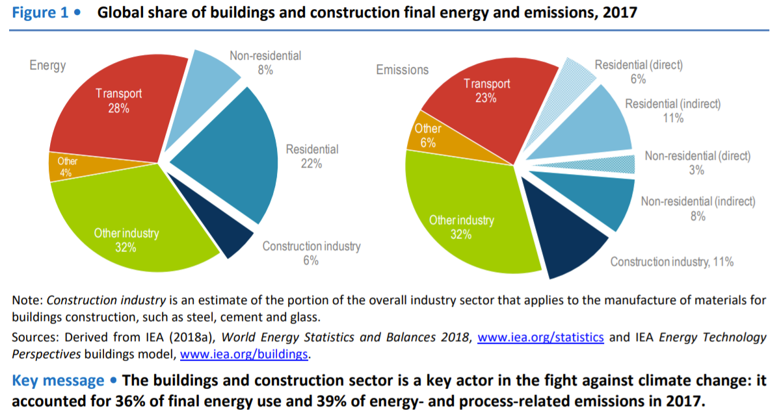
The Project Plan
Focuses on civil engineering and construction sector
It accounts for:-
  36% of global final energy use
  39% of energy‐related CO2 emissions

Slide 28
The Project Plan
The project tasks include:
  To build a database to hold the data and open to WFEO member countries
  To publish technical reports
  To release practice guide
  To hold international conferences and workshops
  To provide training courses
COP27, November 2022, Sharm El-Sheikh, Egypt

Slide 29
The Project Plan
Data Collection – The Questionnaire
01
Design
02
Building materials
03
Construction
04
Operation
05
Reconstruction
06
Waste
07
Macro indicators

Slide 30
The Progress
The Project: WFEO Climate Change Mitigation Best Practice Project
The whole project is divided into two phase.
Phase 1: Small scale data collection and research ( 8-10 national organizations )
Phase 2: Large scale data collection and research ( about 100 national organizations )

Slide 31
The Preliminary Results
Example: Energy Saving on Building Materials
China：
  Developing energy-saving building materials, such as low-radiation coated glass,
  solar power generation materials,
  high-performance thermal insulation materials, etc.
Peru ：
  Concrete partly taken from secondary raw materials
  New types of cement, such as silicate CO2 replacing traditional varieties.
  Bio-aggregates: based on organic materials
Malaysia ：
  Use of Skylight Windows will allow significant amounts of daylight into the office space.
  Use state-of-the-art lighting accounts for approximately 40% of the energy used in a typical commercial building.
  Properly executed daylighting strategies can reduce HVAC peak loads

Slide 32
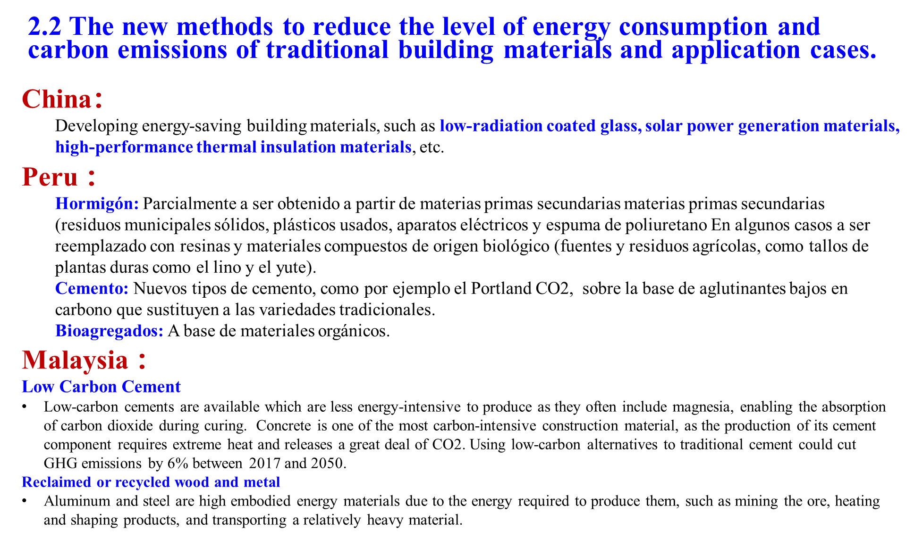
The Preliminary Results
Methods to reduce energy consumption

Slide 33
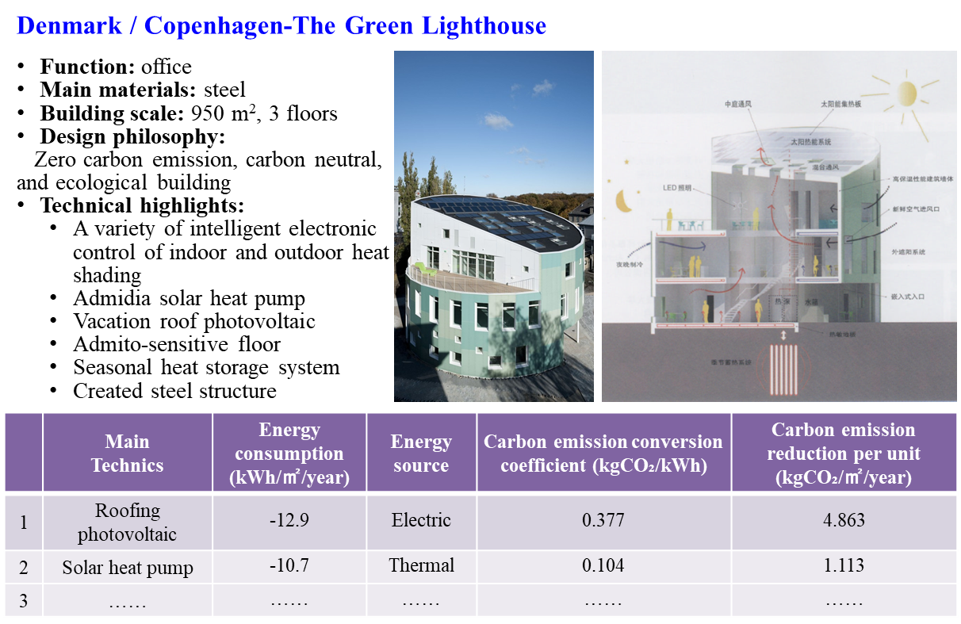
Questionnaire Modification
Use more tables to make the technology data collection more clear
Expand the dimensions of technical description, using the unified template provided
Focus on application cases introduction, using the unified template provided
Technical description (template)
Application case introduction (template)
Name | Definition/Brief introduction | Energy saving potentiality (percent relative to conventional techniques) | Carbon-emission reduction potentiality (percent relative to conventional techniques) | Incremental cost (relative to conventional techniques) | Typical cases (Building name)
LED lighting | LED lighting can make a quick, dramatic impact on your energy consumption. LED lighting also has added benefits of less heat generation thus reducing your air conditioning load as well as reducing your maintenance costs due to the long life of LED lighting | 3%~5% 5 kWh/m2/year | 3%~5% 3 kgCO2/m2/year | 5% (1.2 $/m²) | The Shanghai Academy of Building’s eco-built office building
…

Slide 34

The Supporters
This project was initiated by WFEO CEE, supported by WFEO and its member countries, and hosted by Tsinghua University in China
The WFEO project team welcome broader recognition and support from WFEO member states, international research institutions, societies, and funding institutions to make great success of this ambitious project.

Slide 35
Thanks for your attention
WFEO CLIMATE CHANGE MITIGATION BEST PRACTICE PROJECT TEAM
March 2024

Slide 36
Panel Q&A

Slide 37
Savina Carluccio
Executive Director, International Coalition for Sustainable Development

Slide 38
Thank you
How to get involved
#EngineeringChange:
sustainability-coalition.org/engineeringchange
WFEO: wfeo.org
ICSI Advocacy Statements:
sustainability-coalition.org/publications

