Slide 1
World Federation of Engineering Organizations
Fédération Mondiale des Organisations d’Ingénieurs
Federación Mundial de las Organizaciones de Ingenieros
PRESIDENT´S REPORT
Executive Council Meeting
José M.P. Vieira
Madrid, 01.03.2023

Slide 2
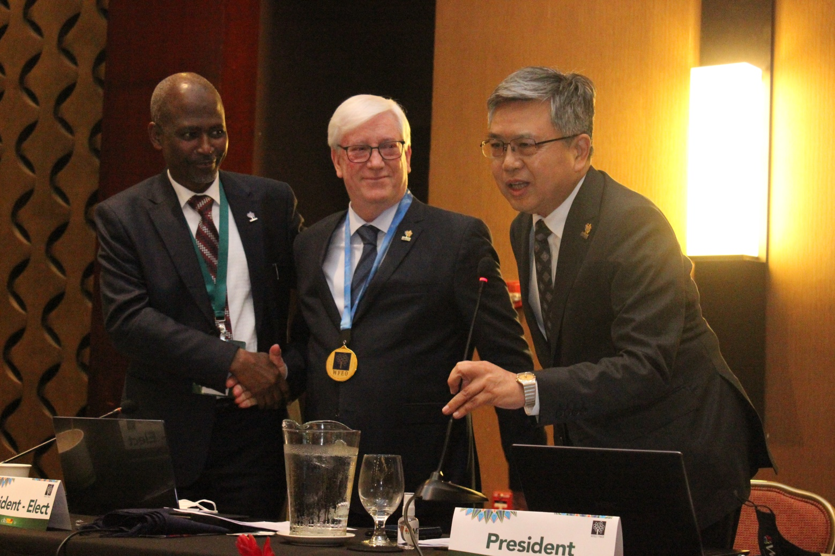
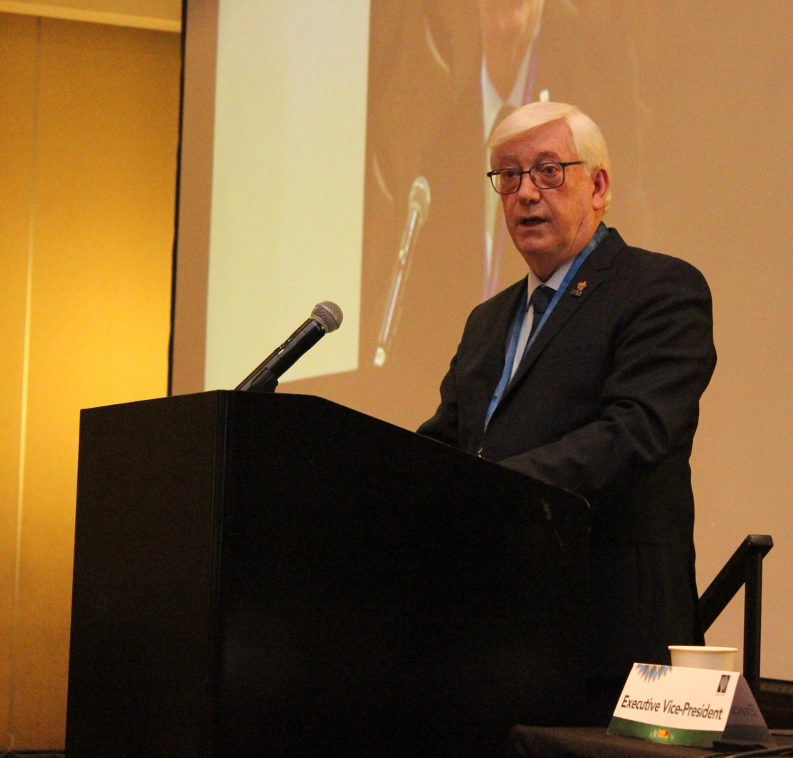
From Paris to Madrid (October 2022 – March 2023)

Slide 3
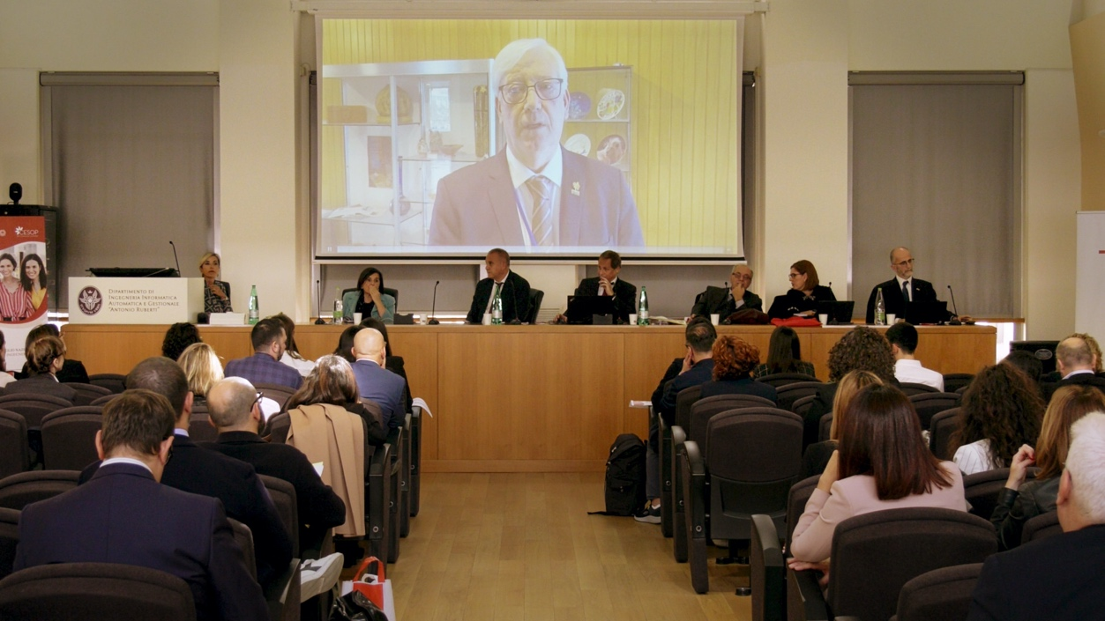
The Award ceremony Second edition of the “Ingenio al Femminile Competition” event, in Roma, Italy
3 November 2022
Prof Dr José Vieira sent a video message, where he declared the importance of quickly reach the UN SDG #5 of the Agenda 2030 :“Achieve gender equality”.
Poor infrastructure

Slide 4
WFEO-WIE webinar Gender Perspectives on
Achieving the SDG 5
19 November 2022
Organized by the WFEO Committee on Women in Engineering (WIE), the Institution of Engineering and Technology (IET), the International Network of Women Engineers and Scientists (INWES), the Nigerian Society of Engineers (NSE) and the Technological Association, Malaysia, to celebrate International Men’s Day.
Prof Dr José Vieira gave the opening remarks.
Poor infrastructure

Slide 5
WFEO Webinar on Climate Change
5 December 2022
Organized by WFEO, with representatives from many WFEO Standing Technical Committees.
Prof Dr José Vieira gave the opening remarks.
Poor infrastructure

Slide 6
17th General Assembly of the World Council of Civil Engineers (WCCE)
25 to 28 January 2023
Organized by Ordem Dos Engenheiros de Portugal, in Porto.
Poor infrastructure

Slide 7
WFEO Academy first newsletter
20 February 2023
Prof Dr José Vieira wrote the message of the first WFEO Academy newsletter.
Poor infrastructure

Slide 8
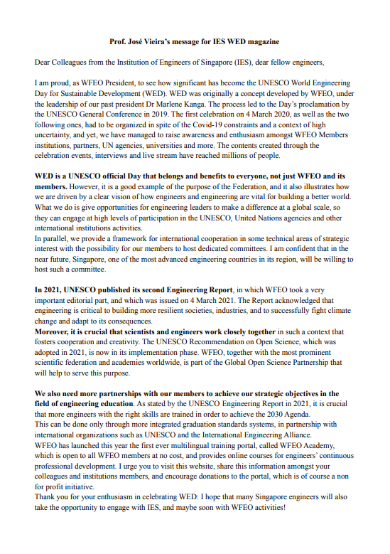
Editorial message for the Singapore Engineer Magazine
22 February 2023
Prof Dr José Vieira wrote an editorial for the Singapore Engineer Magazine.
Poor infrastructure

Slide 9
Statement following the earthquake in Syria and Turkiye
February 2023
Prof Dr José Vieira wrote a Statement following the earthquake in Syria and Turkiye.
Poor infrastructure

Slide 10
WFEO-YEFL Webinar “Smart Sustainable Communities and Frontier Technologies”
24 February
Prof Dr José Vieira gave the opening remarks.
Poor infrastructure

Slide 11
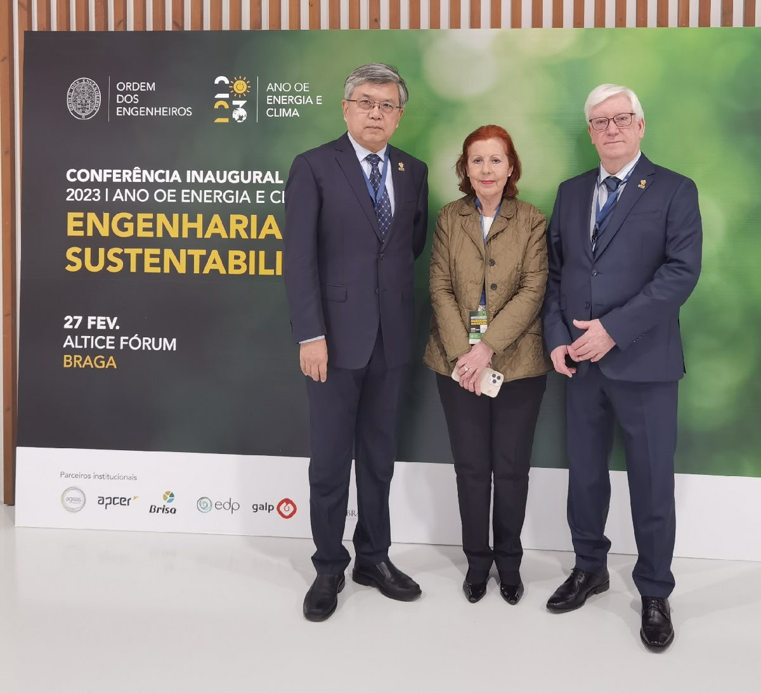
Engineering and Sustainability Inaugural Conference of the ”Year OE 2023:Energy and Climate”
27 February
Prof Dr José Vieira, Member of the European Parliament Graça Carvalho and Immediate Past President Gong Ke at the conference that took place in Braga, Portugal.
Poor infrastructure

Slide 12
UN 2023 Water Conference
22 March 2023
UN 2023 Water Conference will take place at UN Headquarters in New York, 22-24 March 2023, co-hosted by Tajikistan and the Netherlands.
Poor infrastructure

Slide 13
Thank you

