Slide 1
World Federation of Engineering Organizations
Fédération Mondiale des Organisations d’Ingénieurs
Official partner of UNESCO (associate status)
PRESIDENT´S REPORT
General Assembly
José M.P. Vieira
Praha, 14.10.2023

Slide 2
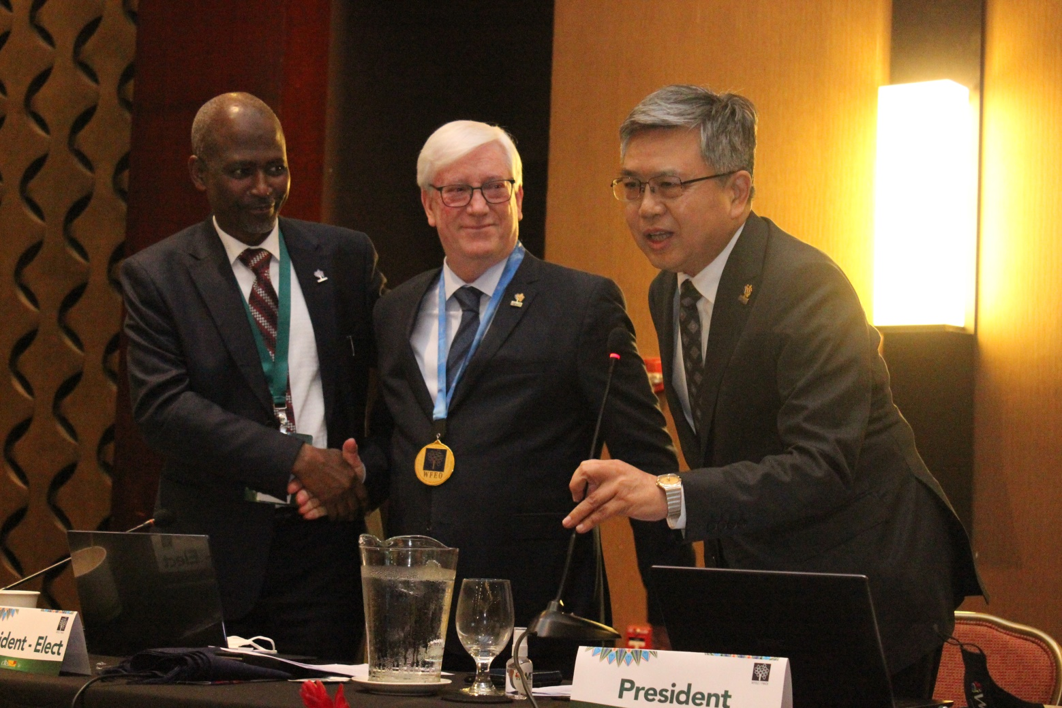
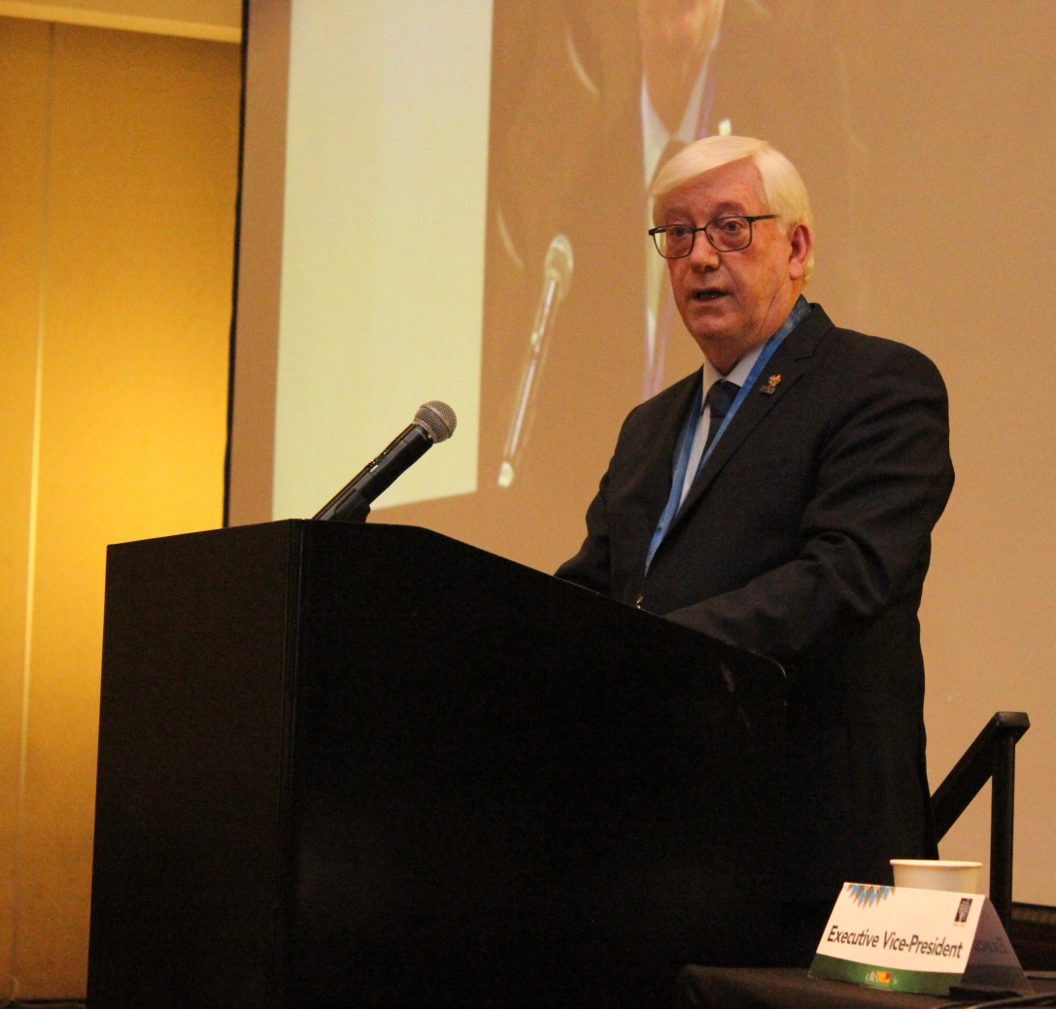
From San José Costa Rica to Prague (March2022 – October 2023)

Slide 3
Outline
The priorities of the biennial term
Strengthen international collaboration
WFEO Academy
World Engineering Day
Visibility of STC/PIC initiatives
WFEO Model Code of Ethics
Internal affairs (membership, newsletter, SJH)

Slide 4
The priorities of the biennial term
Based on the WFEO's strategic goals and the needs of WFEO member organizations
Assessment of Global Engineering Challenges
The president should conduct a comprehensive assessment of the current global engineering landscape. Identifying key challenges such as climate change, sustainable development, infrastructure, and technology innovation
Member Engagement
Engaging with member organizations to understand their concerns, challenges, and goals. Regular consultations can help in aligning WFEO's priorities with the needs of its members
Strategic Planning
fulfilling the WFEO strategic plan that outlines the organization's mission, vision, and specific goals for the biennial term. This plan should be based on the identified challenges and member input

Slide 5
The priorities of the biennial term
Based on the WFEO's strategic goals and the needs of WFEO member organizations
Advocacy and Policy Influence
Identifying opportunities for advocacy and policy influence on a global scale. This might involve collaborating with governments, international organizations, and NGOs to shape policies related to engineering, technology, and sustainable development
Capacity Building
Focusing on capacity building initiatives, especially in developing countries, to enhance engineering education, skills, and professional standards. This can involve organizing workshops, training programs, and knowledge sharing sessions
Diversity and Inclusion
Promoting diversity and inclusion within the engineering profession. Encouraging participation from underrepresented groups, including women and minorities, and ensuring equal opportunities for all engineers

Slide 6
The priorities of the biennial term
Based on the WFEO's strategic goals and the needs of WFEO member organizations
Ethics and Professionalism
Emphasizing the importance of ethics and professionalism in engineering practice. Updating WFEO guidelines and standards for ethical conduct and promoting adherence to these principles among engineers worldwide.
Public Outreach and Education
Raising public awareness about the role of engineering in society. Educating the public about the contributions of engineers and the impact of engineering solutions on global challenges
Financial Health
The organization must prioritize efforts to ensure a healthy financial situation, securing sustainable funding sources and managing resources efficiently to support its mission and initiatives effectively

Slide 7
Strengthen international collaboration
WFEO holds recognition from the United Nations as a leading non-governmental organization in science and technology. The primary objective of these collaborations has been to address significant global issues, with a particular emphasis on advancing the SDGs through engineering

Slide 8
Strengthen international collaboration
2022
The WFEO awarding ceremony 12 APR
The WFEO awards online ceremony was held in presence of UNESCO Assistant Director General for Natural Sciences Dr. Shamila Nair-Bedouelle
Prof Dr José Vieira gave the closing remarks

Slide 9
Strengthen international collaboration
2022
Side event at the UN STI Forum "Engineering Resilience in Disaster Risk Management for Sustainable Development“ 5 MAY
Organized by WFEO, CIP, ASCE, UNESCO and ISC, the theme was “Engineering Resilience in Disaster Risk Management for Sustainable Development”
Prof Dr José Vieira gave the opening remarks

Slide 10
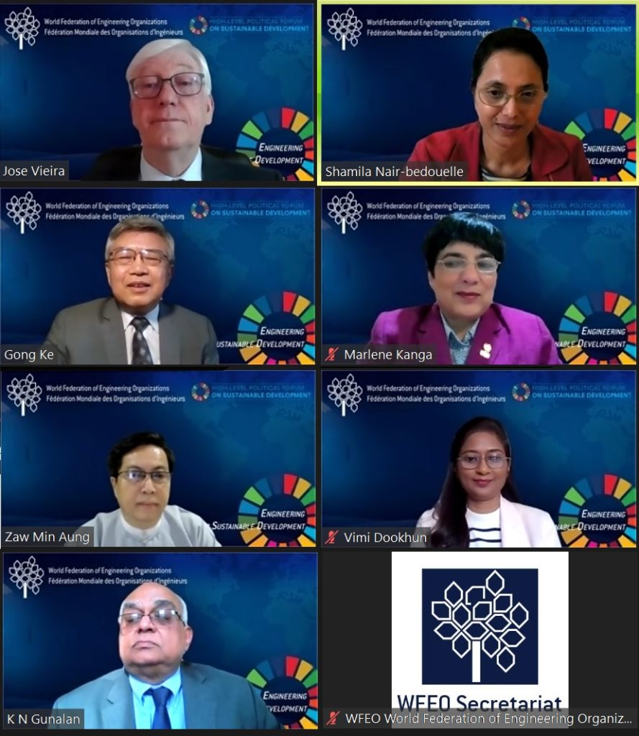
Strengthen international collaboration
2022
Side event at UN HLPF 2022 "Utilizing Open Science Principles for Quality Engineering Education to advance the UN SDGs" 6 JULY
Organized by WFEO and UNESCO
Prof Dr José Vieira was the moderator remarks

Slide 11
Strengthen international collaboration
2022
Side event at UN HLPF 2022 "SDG midterm review: what have we learned from implementation to date? How can we fast-track progress?“ 7 JULY
Organized by WFEO and the International Science Council
Prof Dr José Vieira moderated the event with Peter Gluckman, ISC President

Slide 12
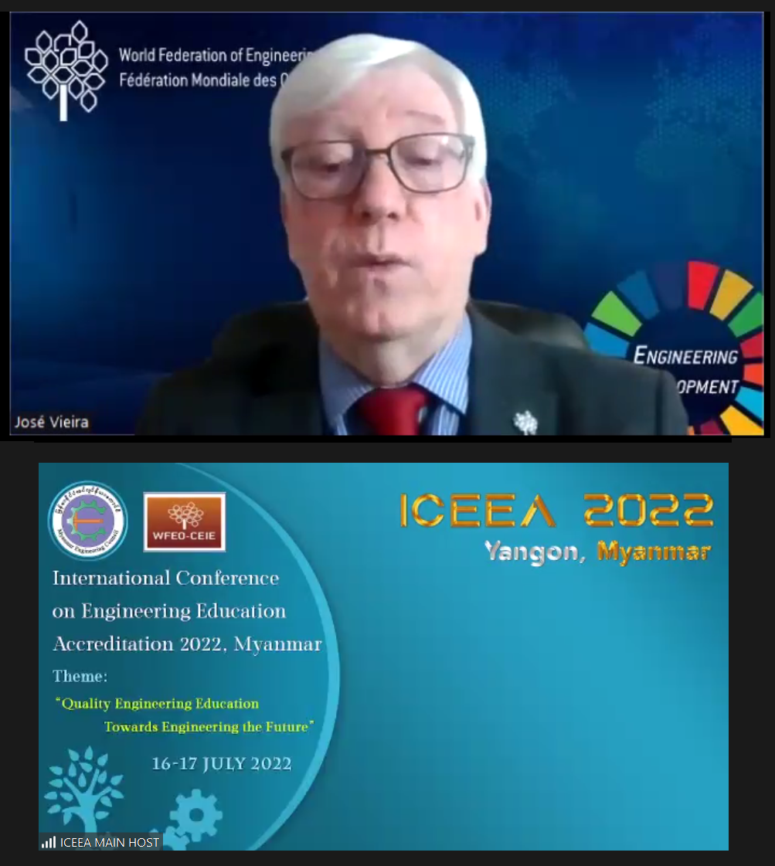
Strengthen international collaboration
2022
International Conference on Engineering Education Accreditation ICEEA 2022 16-17 JULY
Hosted by the Myanmar Engineering Council, the theme was "Quality Engineering Education Towards Engineering the Future"
Prof Dr José Vieira gave the opening remarks

Slide 13
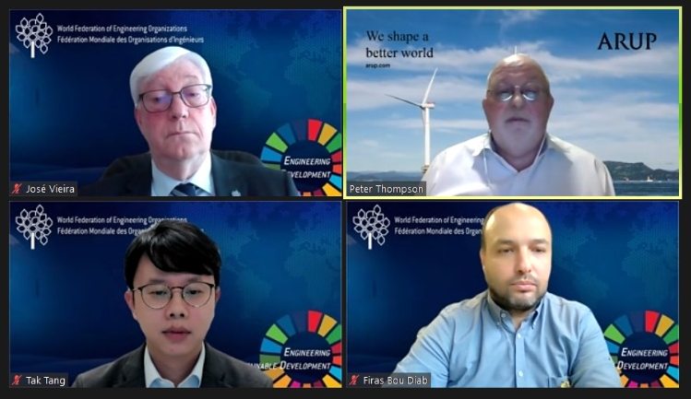
Strengthen international collaboration
2022
WFEO-YEFL webinar series "Engineering the Future – Fulfilling Offshore Wind Potential" 1 SEPTEMBER
Organized by the WFEO Committee on Young Engineers / Future Leaders
Prof Dr José Vieira was one of the speakers

Slide 14
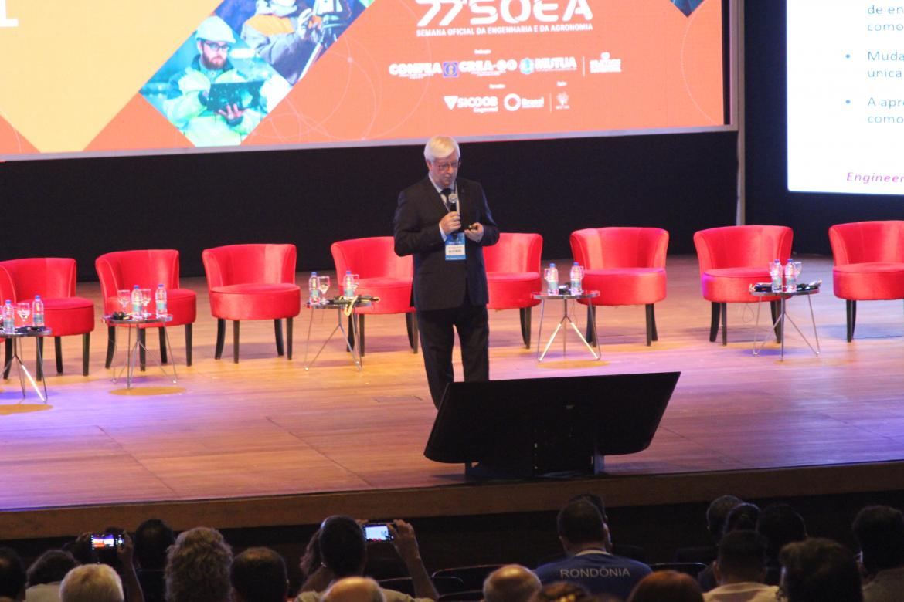
Strengthen international collaboration
2022
77th Engineering and Agronomy Official Week 5 OCT
Organized by CONFEA in Goiânia, Brazil
Prof Dr José Vieira presented the Professional Mobility panel

Slide 15
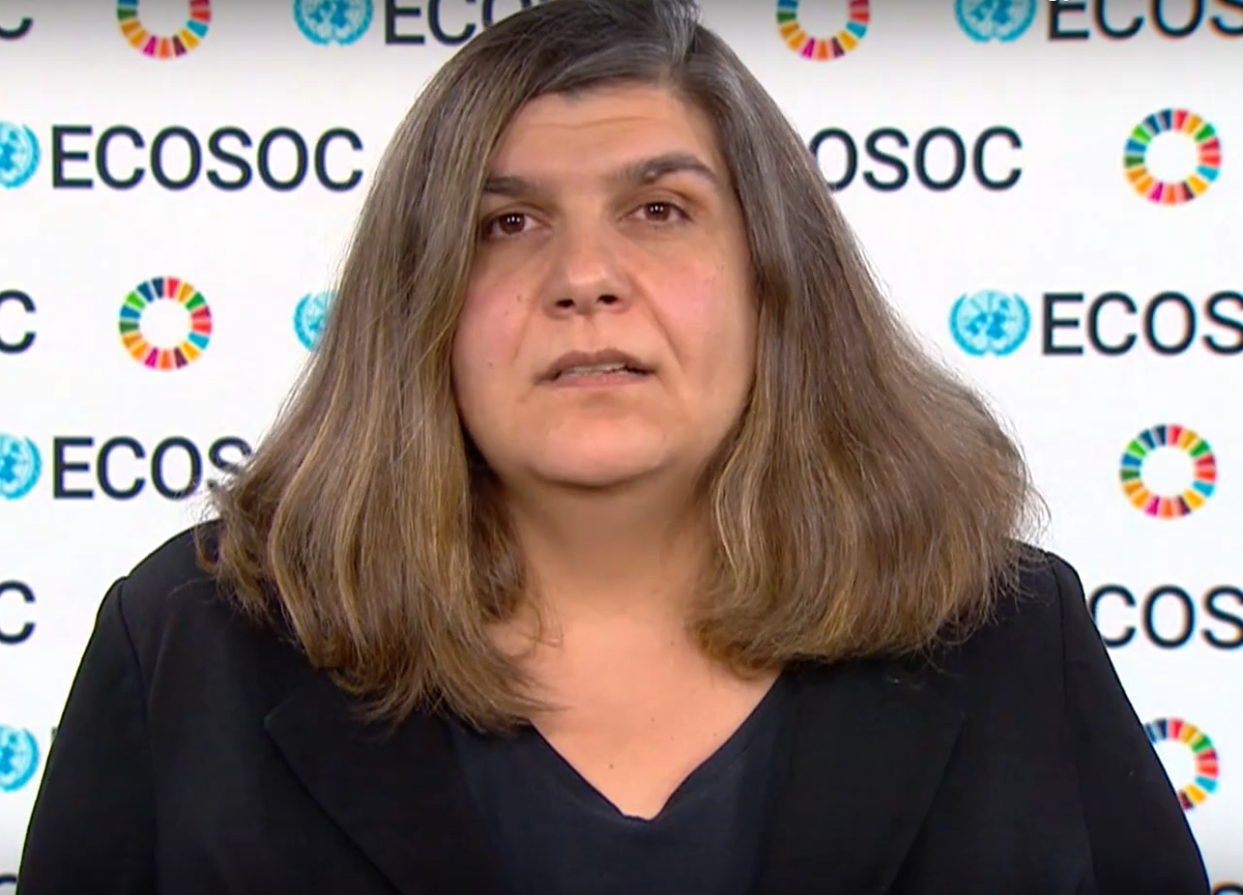
Strengthen international collaboration
2022
Meeting with the UN ECOSOC President 21 OCT
Institutional Online Meeting with Her Excellency Lachezara Stoeva, the President of Department of Economic and Social Affairs Economic Analysis (ECOSOC) of the United Nations

Slide 16
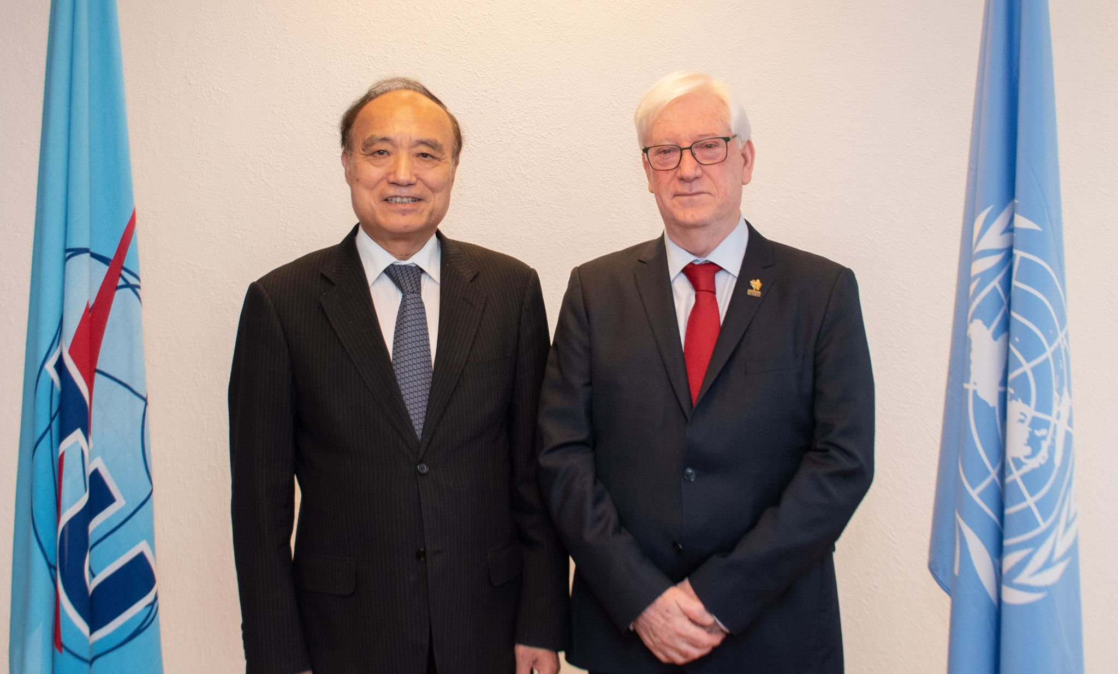
Strengthen international collaboration
2022
Institutional Meeting with the ITU Secretary General 24 OCT
Institutional Meeting in Geneva with Houlin Zhao, the Secretary General of the International Telecommunication Union (ITU) of the United Nations

Slide 17
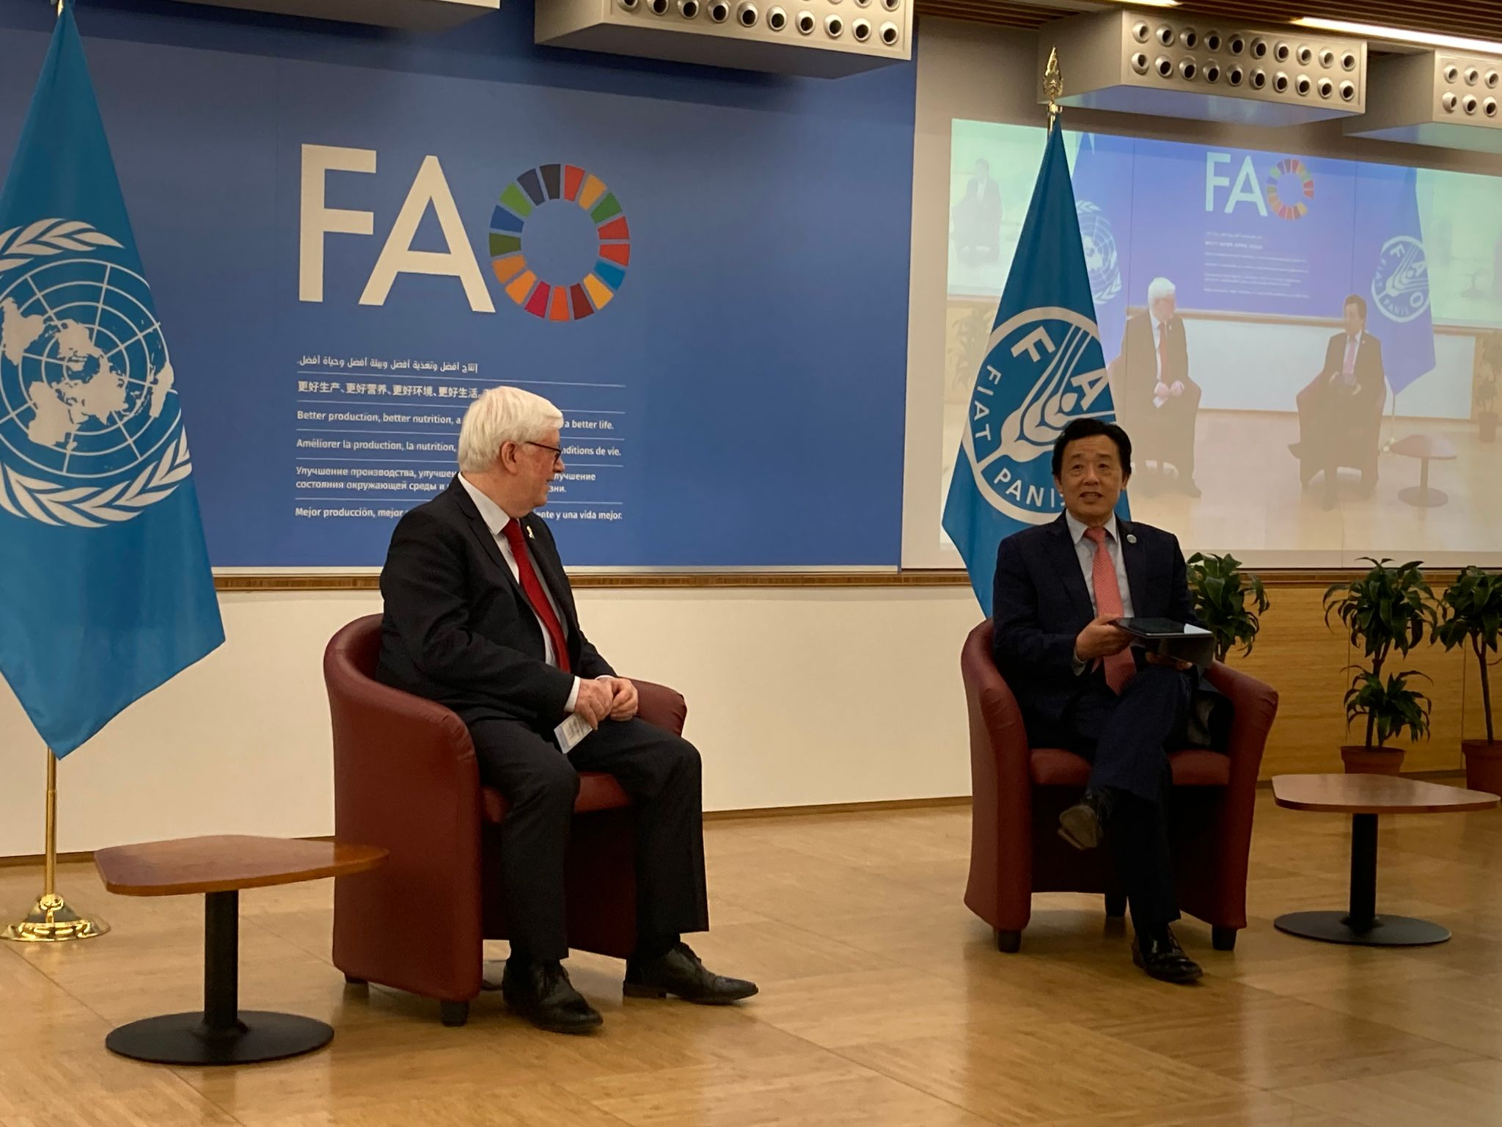
Strengthen international collaboration
2022
Institutional Meeting with the FAO Director General 25 OCT
Institutional Meeting in Rome with QU Dongyu, the Director General of the Food and Agriculture Organisation (FAO) of the United Nations

Slide 18
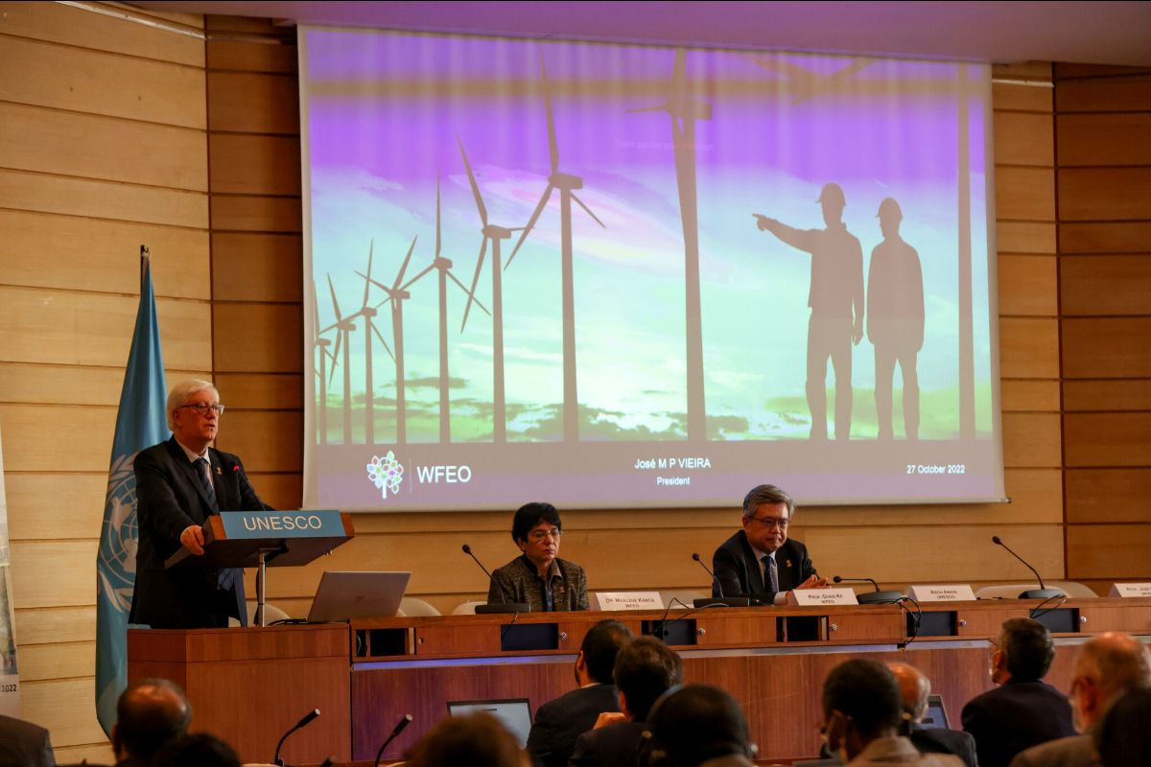
Strengthen international collaboration
2022
WFEO-UNESCO Joint Meeting for Member States – The strategic role of engineering for accelerating the delivery of the 2030 Agenda 27 OCT
General introduction and moderator on Session 2 at the UNESCO HQ, Paris

Slide 19
Strengthen international collaboration
2022
UPADI 2022 Convention and General Assembly 31 OCT
Video message, Bogota, Colombia

Slide 20
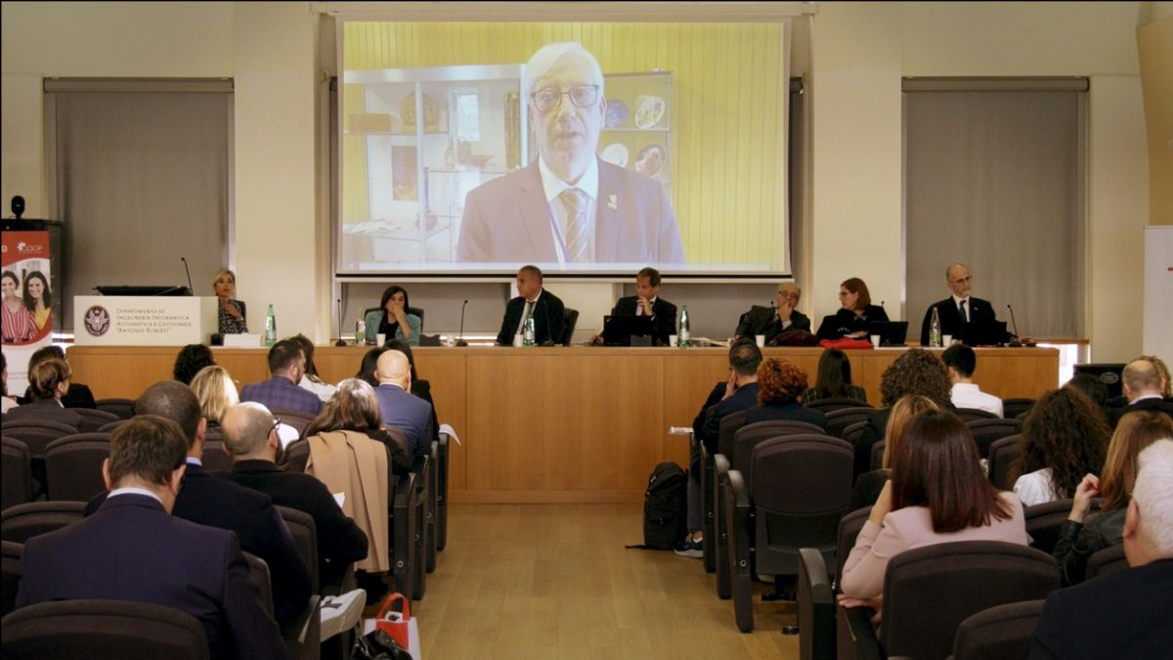
Strengthen international collaboration
2022
Award ceremony of the “Ingenio al Femminile Competition” event 3 NOV
Video Message, Roma, Italy

Slide 21
Strengthen international collaboration
2022
8th UNESCO Africa Engineering Week 7 NOV
Video Message, WHERE

Slide 22
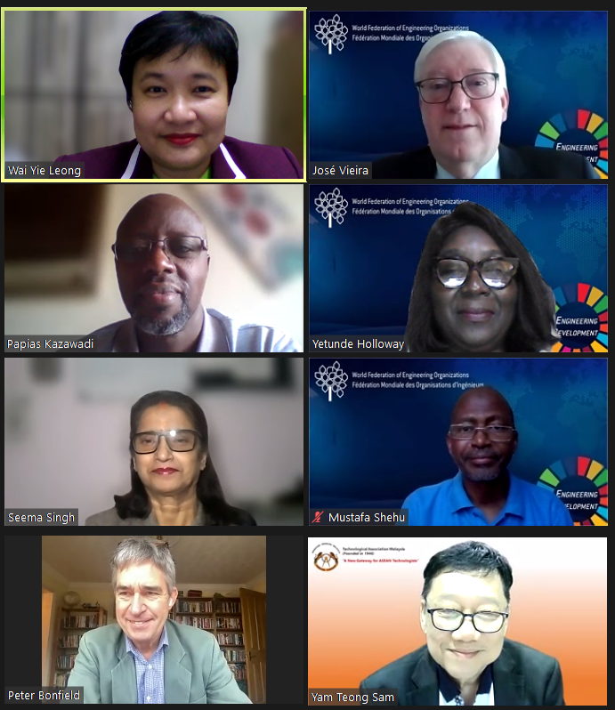
Strengthen international collaboration
2022
WFEO-WIE webinar Gender Perspectives on Achieving the SDG 5 19 NOV
Opening remarks

Slide 23
Strengthen international collaboration
2022
Climate Change Education Workshop Mauritius 22 NOV
Opening video message

Slide 24
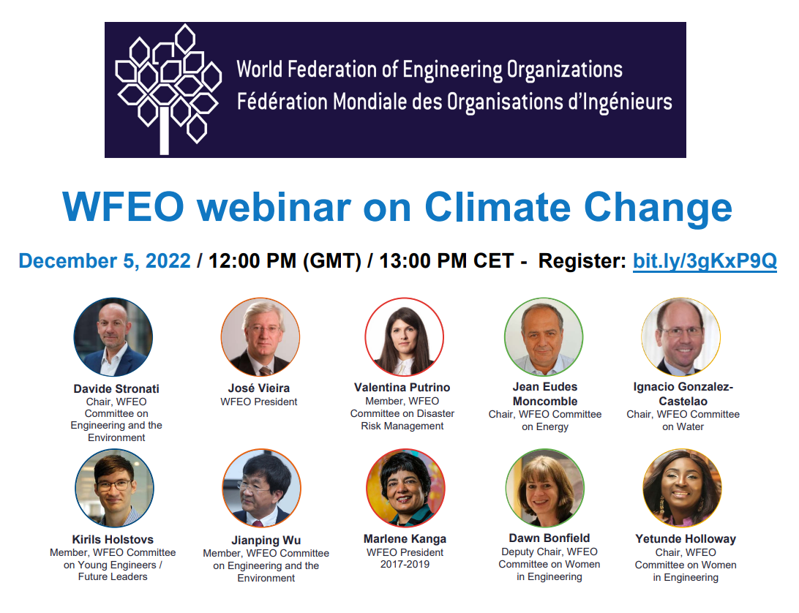
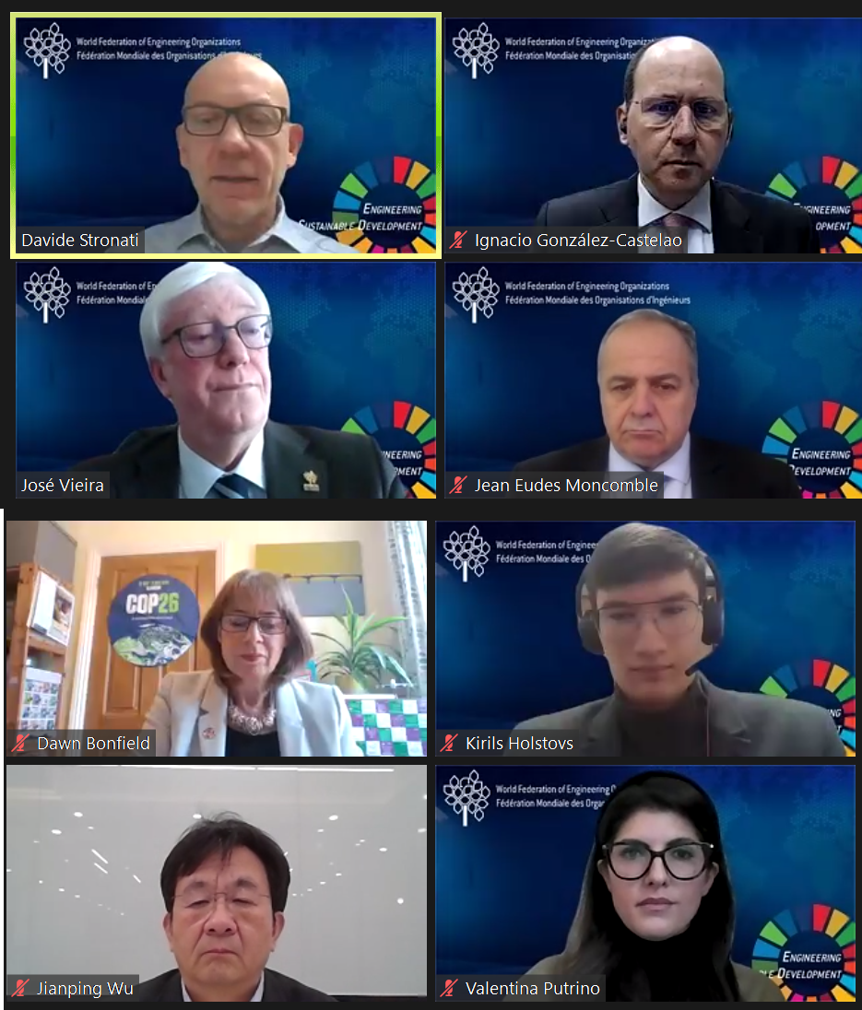
Strengthen international collaboration
2022
WFEO Webinar on Climate Change
5 DEC
Opening remarks

Slide 25
Strengthen international collaboration
2022
37th Indian Engineering Congress 17 DEC
Video message

Slide 26
Strengthen international collaboration
2023
17th General Assembly of the World Council of Civil Engineers 26 JAN
Address and participation, Porto, Portugal

Slide 27
Strengthen international collaboration
2023
FAEO Engineering Policy and Presidential Inauguration
27 JAN
Goodwill video message, Kigali, Rwanda

Slide 28
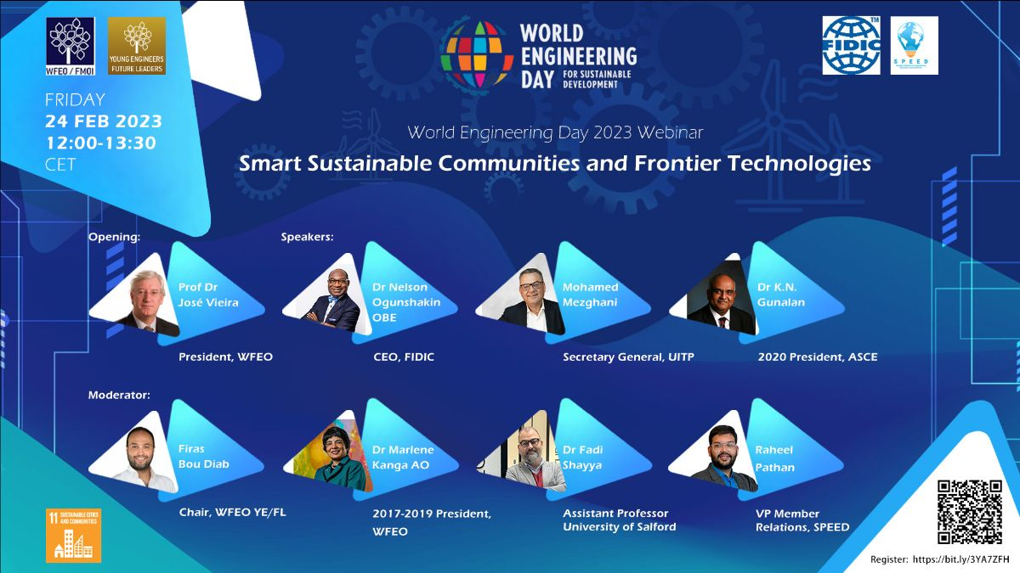
Strengthen international collaboration
2023
WFEO-YEFL Webinar Smart Sustainable Communities and Frontier Technologies 24 FEB
Opening remarks

Slide 29
Strengthen international collaboration
2023
Engineering and Sustainability Inaugural Conference of the Year OE 2023: Energy and Climate Change 27 FEB
Braga, Portugal

Slide 30
Strengthen international collaboration
2023
Conference Engineering the cities of the future 3 MAR
Moderator of Round Table and remarks at
Opening and Closing Ceremonies, Madrid, Spain

Slide 31
Strengthen international collaboration
2023
World Engineering Day 2023 4 MAR
Opening and Closing remarks, Madrid, Spain

Slide 32
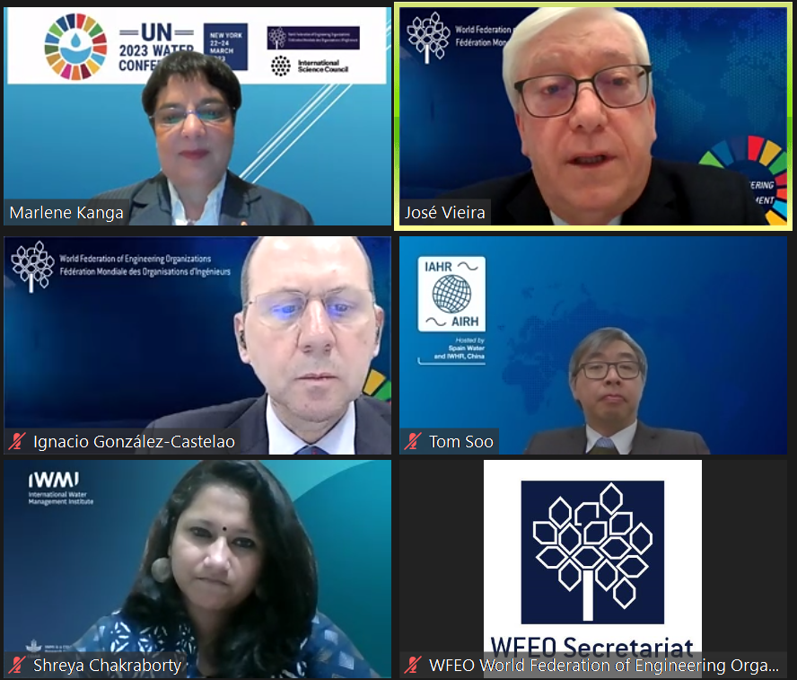
Strengthen international collaboration
2023
WFEO-ISC Side-Event at the UN 2023 Water Conference 23 MAR
Moderator, UN HQ, New York

Slide 33
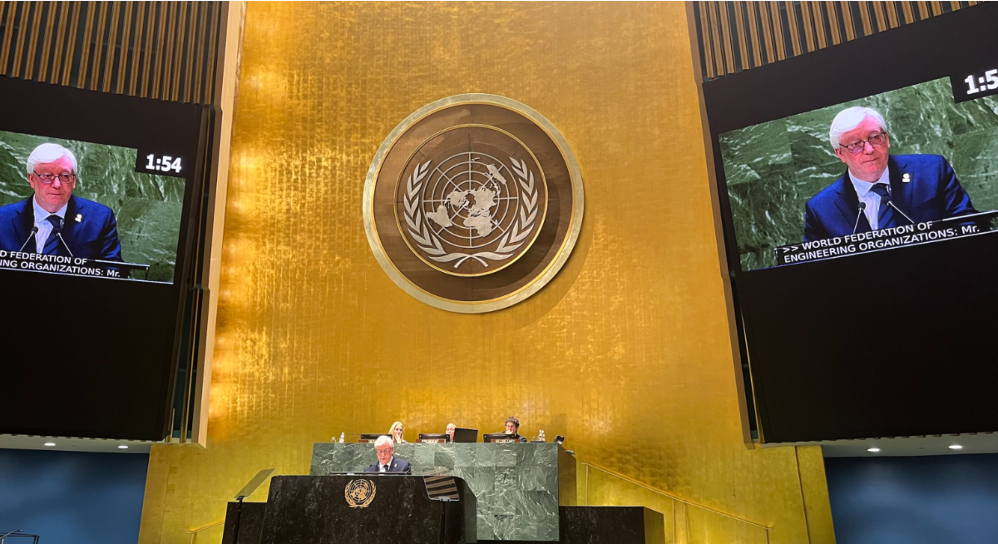
Strengthen international collaboration
2023
UN 2023 Water Conference plenary session 23 MAR
Statement address, UN HQ, New York

Slide 34
Strengthen international collaboration
2023
H.J. Sabbagh Prize for Excellence in Engineering Construction Ceremony 2023 21 APR
Welcome video message

Slide 35
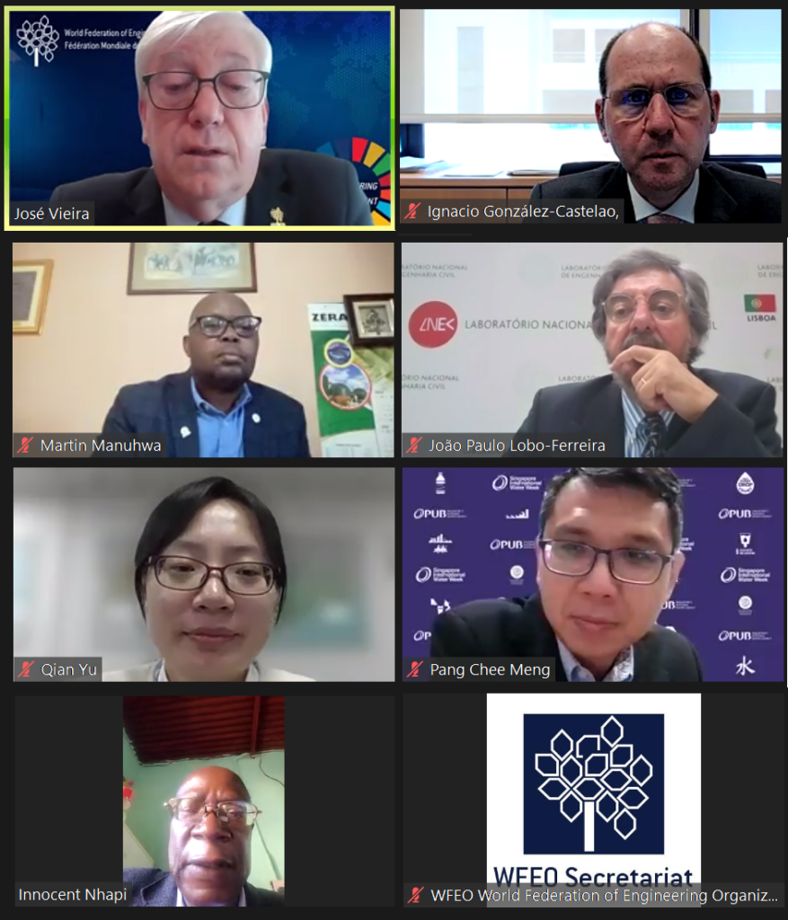
Strengthen international collaboration
2023
WFEO Side-event at UN STI Forum Engineering solutions for water adaptation 4 MAY
Moderator

Slide 36
Strengthen international collaboration
2023
Conference on Engineering Education Accreditation ICEEA 2023 27 JUL
Video message

Slide 37
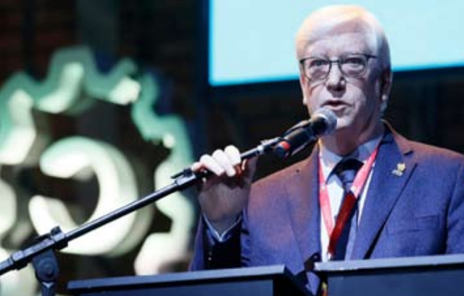
Strengthen international collaboration
2023
78th SOEA: Engineering and Agronomy Official Week 8 AUG
Opening address and participation, Gramado, Brazil

Slide 38
Strengthen international collaboration
2023
8th World Robot Conference 2023 17 AUG
Opening address and participation, Beijing, China

Slide 39
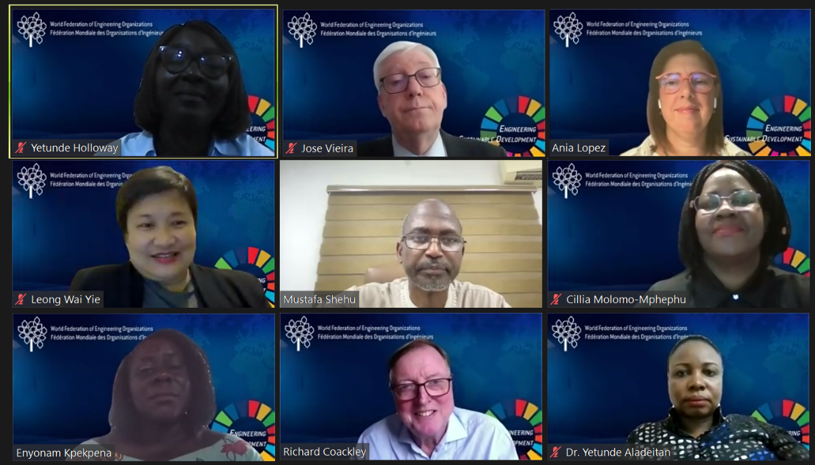
Strengthen international collaboration
2023
WFEO-WIE webinar Resilient
Women, Resilient World 1 SEP
Opening remarks

Slide 40
Strengthen international collaboration
2023
CAST/WFEO-China Conference 2023 High-level Seminar on Engineering Innovation for a More Resilient World 5 SEP
Opening video message

Slide 41
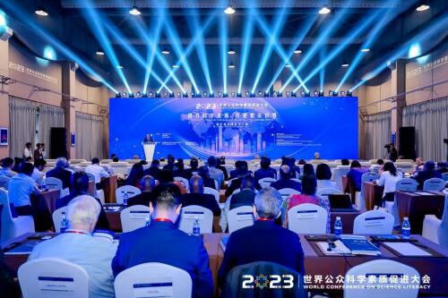
Strengthen international collaboration
2023
CAST 2023 Conference on Science Literacy 19 SEP
Opening video message

Slide 42
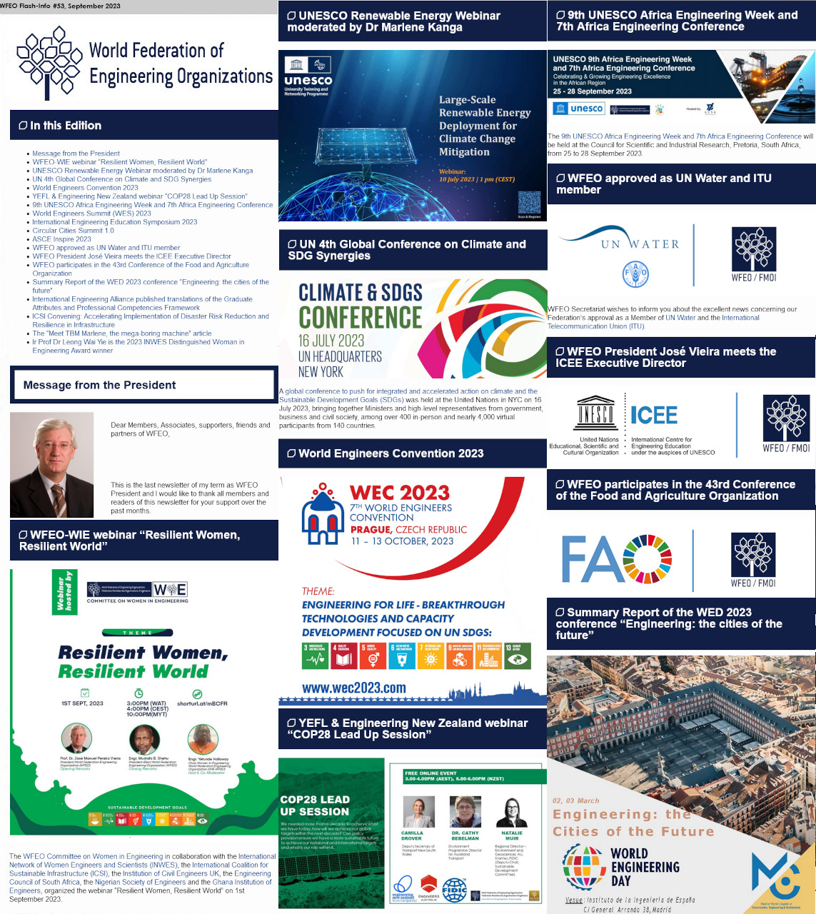
Internal affairs
WFEO Newsletter
12 WFEO Newsletters
Regular information so that the members could be better informed about WFEO activities ensuring a high participation and engagement of our Members in the Federation businesses

Slide 43
Internal affairs
Saint James House (SJH) contract
Contract purpose:
License SJH as an exclusive partnering sponsor (representative) of WFEO in relation to UNESCO World Engineering Day for a four (4) year period, spanning 2025 to 2028, as to recruit sponsors, and deliver the event’s website
Schedule: Signature in October 2023
First WED delivered: March 2025
Main deliverables
Building a new official WED website (Hub) and providing content (text, data, video, etc), especially micro-websites for sponsors.
Managing the WED website during the celebration Day, including existing items to stream WFEO members and partners events, hackathon, etc, in partnership with the existing contractor
Contract financial aspects
250,000€ yearly fee for 4 years, i.e. a total fee of 1,000,000€

Slide 44
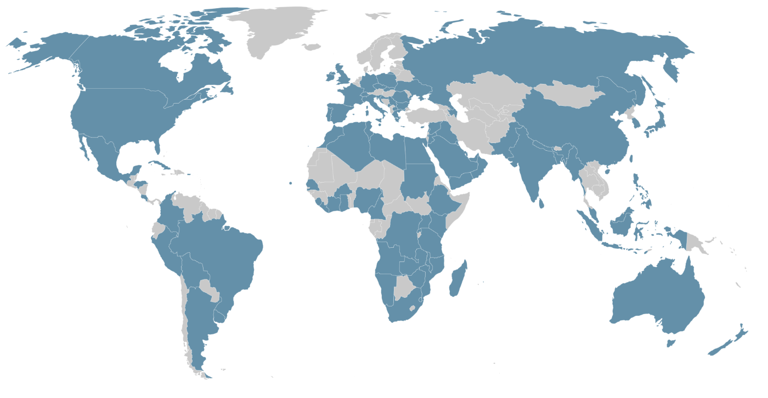
Internal affairs
Membership movement
Year | New Members |  | Leaving Members
 | National | Affiliate
2022 | Burkina Faso Cabo Verde Liberia Mozambique | EBKenya MyanmarES
2023 | Azerbaijan Ireland | USA-ABET | Algeria Puerto Rico Qatar EAMC
Total | 9 |  | 4

