Slide 1

The World Federation of Engineering Organizations
Engineering for Sustainable Development
www.wfeo.org

Slide 2

The peak international organization for the engineering profession
Founded in 1968
Under the auspices of UNESCO
90+ national engineering institutions
Representing some 30 million engineers

Slide 3
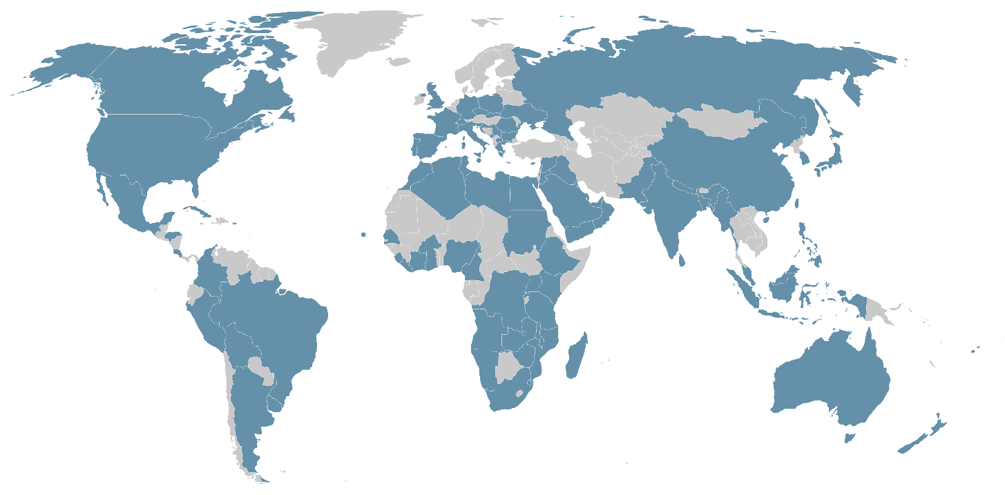
Singapore
Slovakia
Slovenia
South Africa
Spain
Sri Lanka
Sudan
Switzerland
Syria
Tanzania
Tunisia
Uganda
United Arab Emirates
United Kingdom
United States of America
Ukraine
Uruguay
Yemen
Zambia
Zimbabwe
Algeria
Angola
Argentina
Australia
Bahrain
Bangladesh
Bolivia
Brazil
Bulgaria
Burkina Faso
Cabo Verde
Cameroon
Canada
China
Chinese Taipei
Colombia
Costa Rica
Côte d'Ivoire
Malaysia
Malta
Mauritius
Mexico
Montenegro
Morocco
Mozambique
Myanmar
Nepal
New Zealand
Namibia
Nigeria
Oman
Pakistan
Croatia
Cyprus
Czech Republic
DR Congo
Ecuador
Egypt
Fiji
France
Germany
Ghana
Greece
Honduras
Hong Kong
India
Iraq
Italy
Japan
Jordan
Kenya
Korea
Kuwait
Lebanon
Liberia
Libya
Madagascar
Malawi
Palestine
Peru
Poland
Portugal
Puerto Rico
Romania
Russia
Rwanda
Saudi Arabia
Senegal
Serbia
Sierra Leone

Slide 4

Associate NGO at UNESCO
Co-leader of the Scientific and Technological Community Major Group at the UN
13 x Standing Technical and Policy Implementation Committees and Working Groups
Executive Council and Executive Board
General Assembly
Supported by a secretariat based in Paris

Slide 5
WFEO Committees and Working Groups
Engineering and the Environment (Hosted by UK)
Energy (Hosted by France)
Engineering Education (Hosted by Myanmar)
Information and Communication (Hosted by India)
Engineering and Innovative Technologies (Hosted by China)
Engineering Capacity Building (Hosted by Zimbabwe)
Disaster Risk Management (Hosted by Peru)
Anti-Corruption (Hosted by Rwanda)
Women in Engineering (Hosted by Nigeria)
Young Engineers/Future Leaders (Hosted by Lebanon)
Water (Hosted by Spain and Portugal)
and also
UN Relations Committee (Hosted by the USA)
Working Group on Infrastructure Report Card (Hosted by the Federation of African Engineering Organisations)

Slide 6
Influencing… a respected source of advice & guidance on engineering and technology
Supporting… UN sustainable development goals
Partnering… with our international peers in engineering and science
Growing… engineering capacity and mobility
Improving… the ethical engineering practice and a diverse and inclusive profession
Convening… world engineers’ events
Recognising… excellence in engineering

Slide 7

Every one of the UN Sustainable Development Goals
is advanced through engineering

Slide 8



WFEO – UNESCO Declaration,
signed on March 7, 2018

Slide 9

WFEO Engineering 2030 Plan
WFEO Engineering 2030 - A Plan to develop engineering capacity for a sustainable world through partnerships with educators, government, industry and professional engineering institutions
a strategic initiative to address the gap in engineering capacity and the quality of engineering professionals
a recognition that engineers are essential for sustainable development; good engineering is essential achieving UN Sustainable Development Goals Consistent with the mission and objectives of WFEO
WFEO plays a key role in leading and coordinating the Plan
Result of wide consultation between national and international members of WFEO and other international partners
Notes:
(Note "engineers" refers to professional engineers with four-year university engineering degrees as defined by the IEA Washington Accord as well as technologists and technicians with three and two year qualifications respectively. The equivalent definitions of ENAEE also apply.)

Slide 10


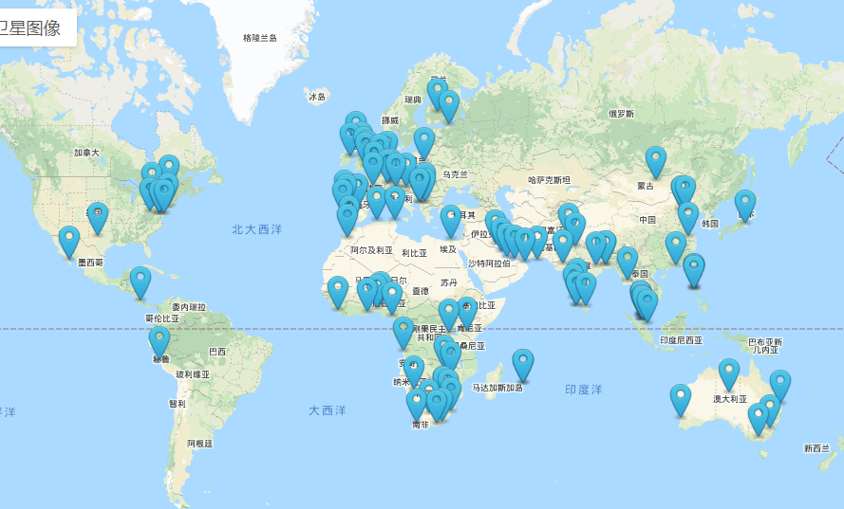


UNESCO World Engineering Day for Sustainable Development - 4th March
A WFEO led initiative that celebrates engineers worldwide,
launched in 2020
Since WED 2022, two new international events are held: the 4 March LIVE streaming of engineers’ events from around the world and the World Engineering Day Students Hackathon.
+100 Global Events - Webinars, Stream, Talks and Competitions, from over 80 countries covering all continents, reached more than 56 million via social media channels.
https://www.worldengineeringday.net

Slide 11

UNESCO Engineering Report - 4 March 2021
Highlights of the Report
Leveraging the crucial role of engineering in delivering the SDGs
Focusing on engineering innovations and Stressing transition of engineering itself
Indicating capacity building is a continuous process and is key for achieving SDGs by engineering
Recognising regional particularities while promoting interregional cooperation
https://en.unesco.org/reports/engineering

Slide 12
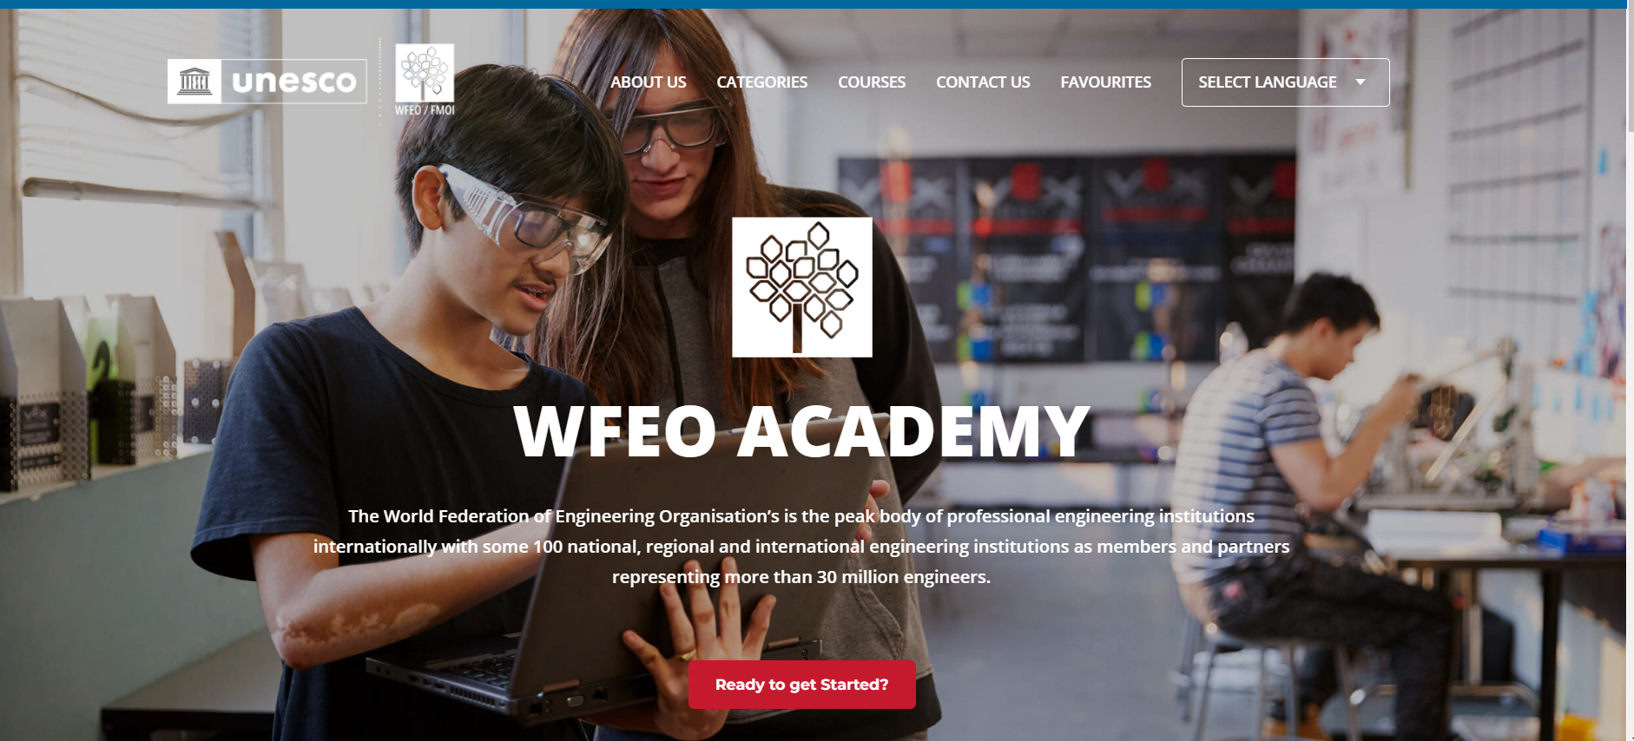
WFEO Academy website – on line training at no cost for WFEO members
Engineering for Sustainable Development

Slide 13









Engineering for Sustainable Development
Notes:
I am pleased to be speaking here today at this event.. AS a past President of WFEO, I am pleased to be working with IEA and for the opportunity to consult with you and seek your feedback on this important project. This is just one of many projects where we are collaborating and I look forward to working with you.

Slide 14

Engineering for Sustainable Development
Participation
Advocacy
Representation

Slide 15

The world’s engineers
united in rising to
the world’s challenges.
For a better, sustainable world.
World Federation of Engineering Organizations
Fédération Mondiale des Organisations d’Ingénieurs
www.wfeo.org secretariat@wfeo.org @wfeo

